Slide 1
Process Documentation of Secure Test Serverless Online Test

Slide 2
Services used for Project
1.AWS Lambda
1.Triggers
2.Cloud Watch Logs
2.S3 (Simple Storage Service)
1.Bucket
3.AWS RDS
1.Database
2.CloudWatch Metrics ,Logs & Events
4.Dbeaver(To Display data in RDS)

Slide 3
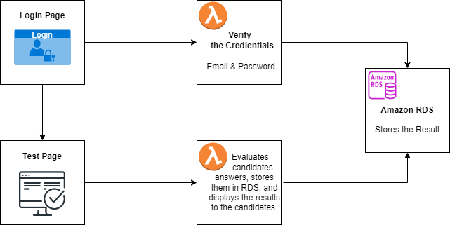
Flowchart of Project

Slide 4
1.Sign-in to AWS Root Account
1.Search for AWS Management Console in Browser.
2.Open to the AWS Management Console.
3.Click on “Sign In to the Console”.
4.Choose “Root user” as the login method.
5.Enter Email and Password that is associated with your AWS root account.
6.Click on Sign in.

Slide 5
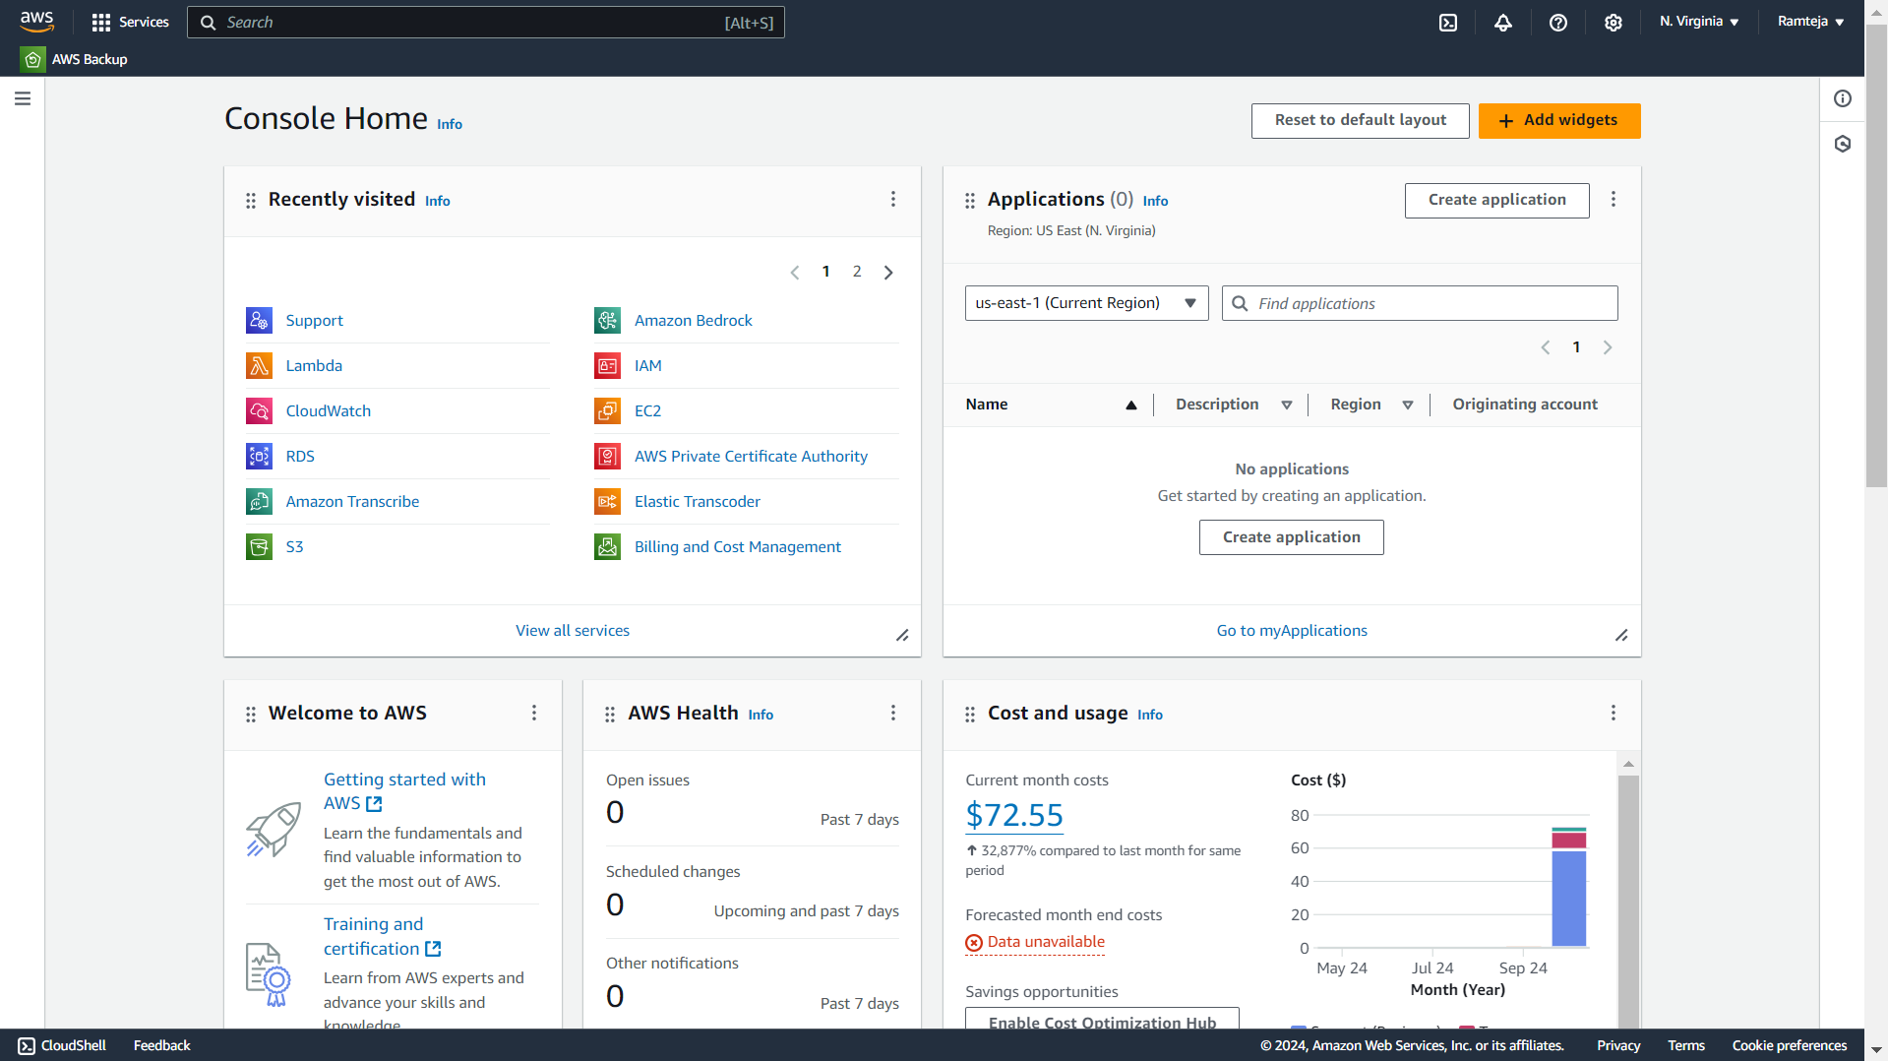
1.1 AWS Console Home.

Slide 6
2.SettingUp Lambda
1.Search for Lambda in Search bar and open Lambda dashboard.
2.Click on Create Lambda Function , Assign a Name to Lambda & Runtime(Language) , Select Architecture as x86_64 , Click on Create a new role with basic lambda Permissions , Create.
3.Click on Add Trigger , Search for API Gateway , in intent block - checkmark on Create new API , in API type block select REST API , in Security dropdown select Open and Add it.
4.Click on Code in Lambda Function , Click on Upload from , select the ZIP file ,click on “Upload to” Upload the zip file in Lambda function & the code will be Deployed if not Click on Deploy.
5.Click on Configuration in Lambda Function to get API Endpoint & Copy it.
6.Open VScode, Paste the API Endpoint in JavaScript code , Open the website ,enter the data that has to send to Lambda & , Click on the button to Hit a request to Lambda Via API Gateway from website.

Slide 7
7.Click on Monitor in Lambda Function ,Click on view Cloud Watch Logs & Open Log groups – “aws/lambda/lambda_name” to watch the logs of the created Lambda Function.
8.We can see the logs of Hitting Request to Lambda via API Gateway from Website of Local Host.
9.When we hit a request from Website to lambda through API Gateway’ end point then API Gateway will receive a request from Website with data & that came in raw body to Lambda Function.

Slide 8
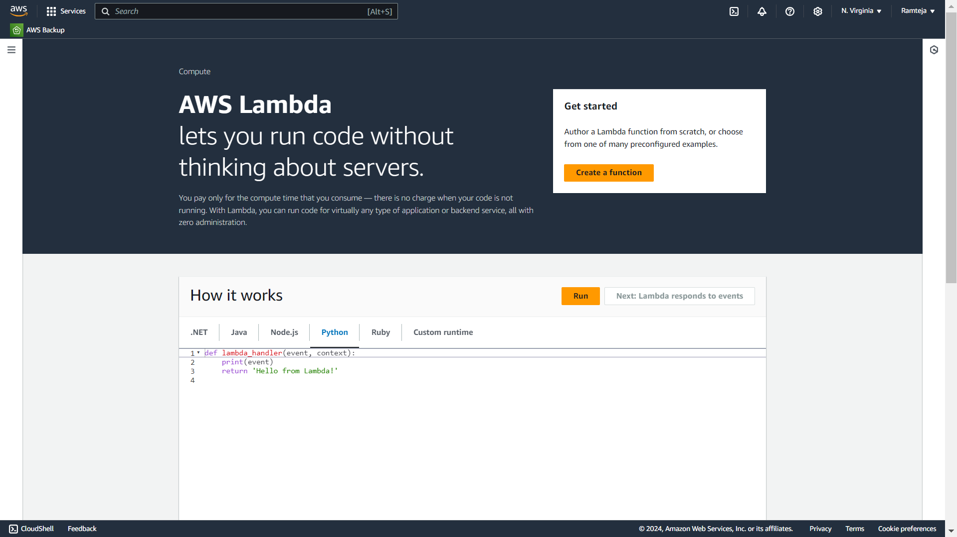
2.1 AWS Lambda Dashboard, Click on Create a function.

Slide 9
2.1 SettingUp Testlogin Lambda
Use of Testlogin Lambda:
1.It is used to take the data of Testlogin page from website to AWS Lambda.
2.If any data is missed it returns missing data field.
3.It Takes email & password, when login button is clicked , it sends the data to AWS lambda & then lambda connects to RDS.
4.If email does not match in database then it returns Invalid Email.
5.If password doesn’t match in database for Corresponding email then it returns Invalid Password.
6.If both email & password are wrong then it returns Invalid Credentials.
7.In RDS ,it Checks if the email exists in database or not, if exists then checks the corresponding password, if both matches it is directed to Start test page.

Slide 10
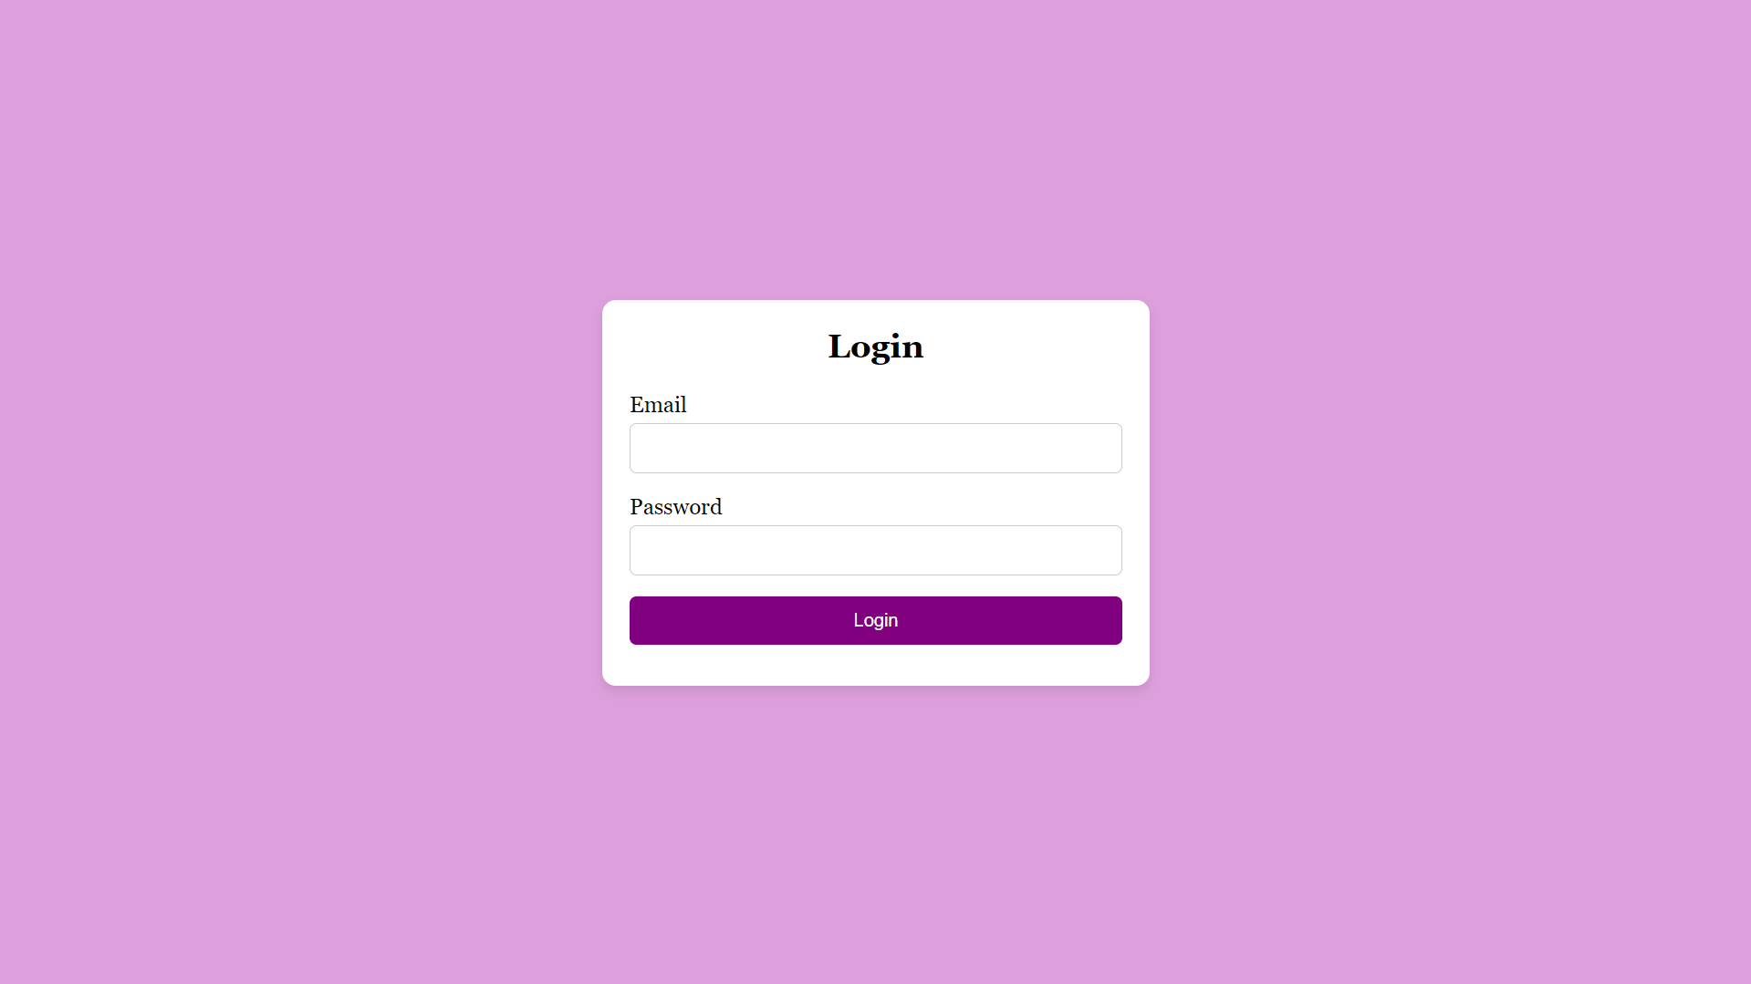
Login Page

Slide 11
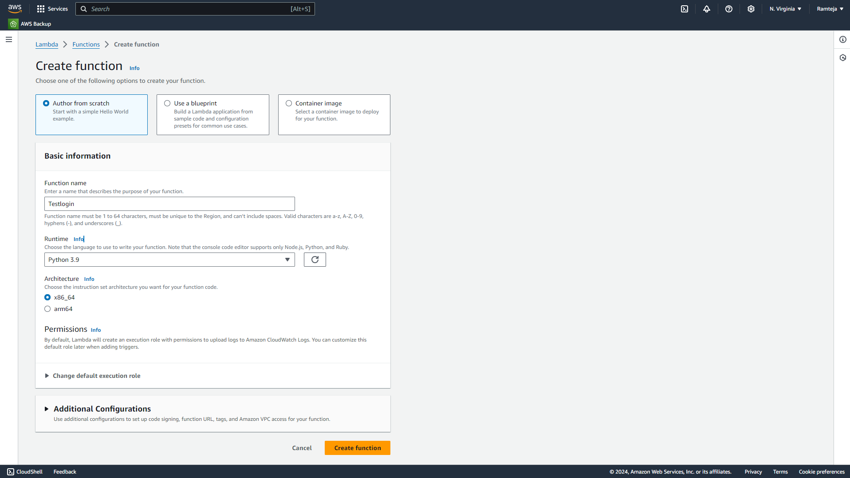
2.1.1 Create lambda function for TestLogin page.

Slide 12
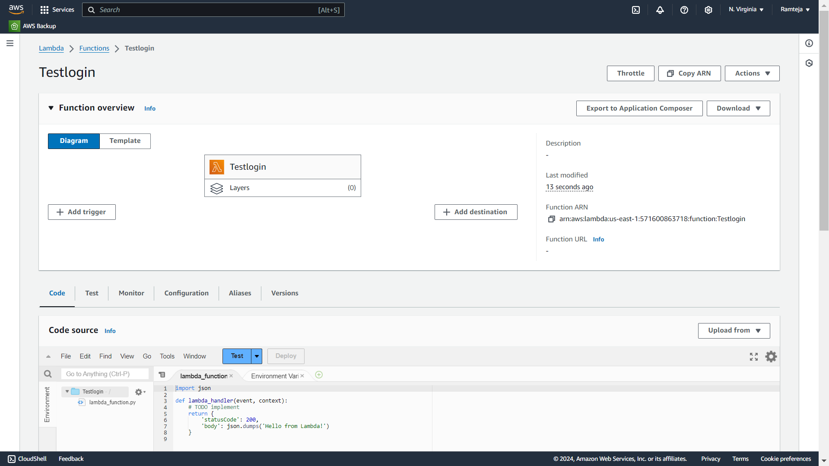
2.1.2 Lambda function “Testlogin” is Created, Click on Add trigger.

Slide 13
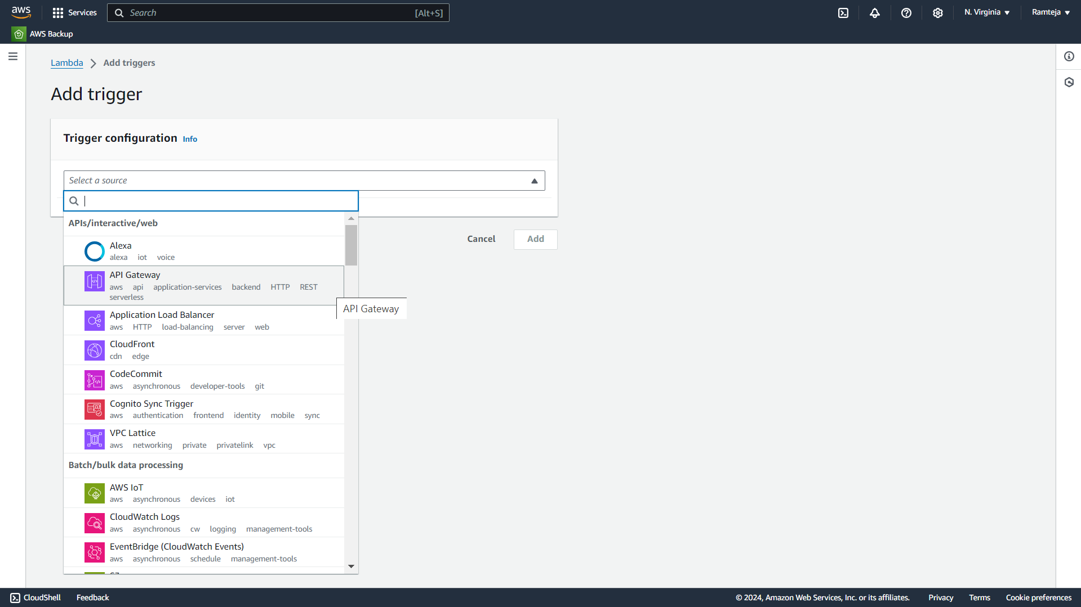
2.1.3 Select the API Gateway in Trigger Configuration.

Slide 14
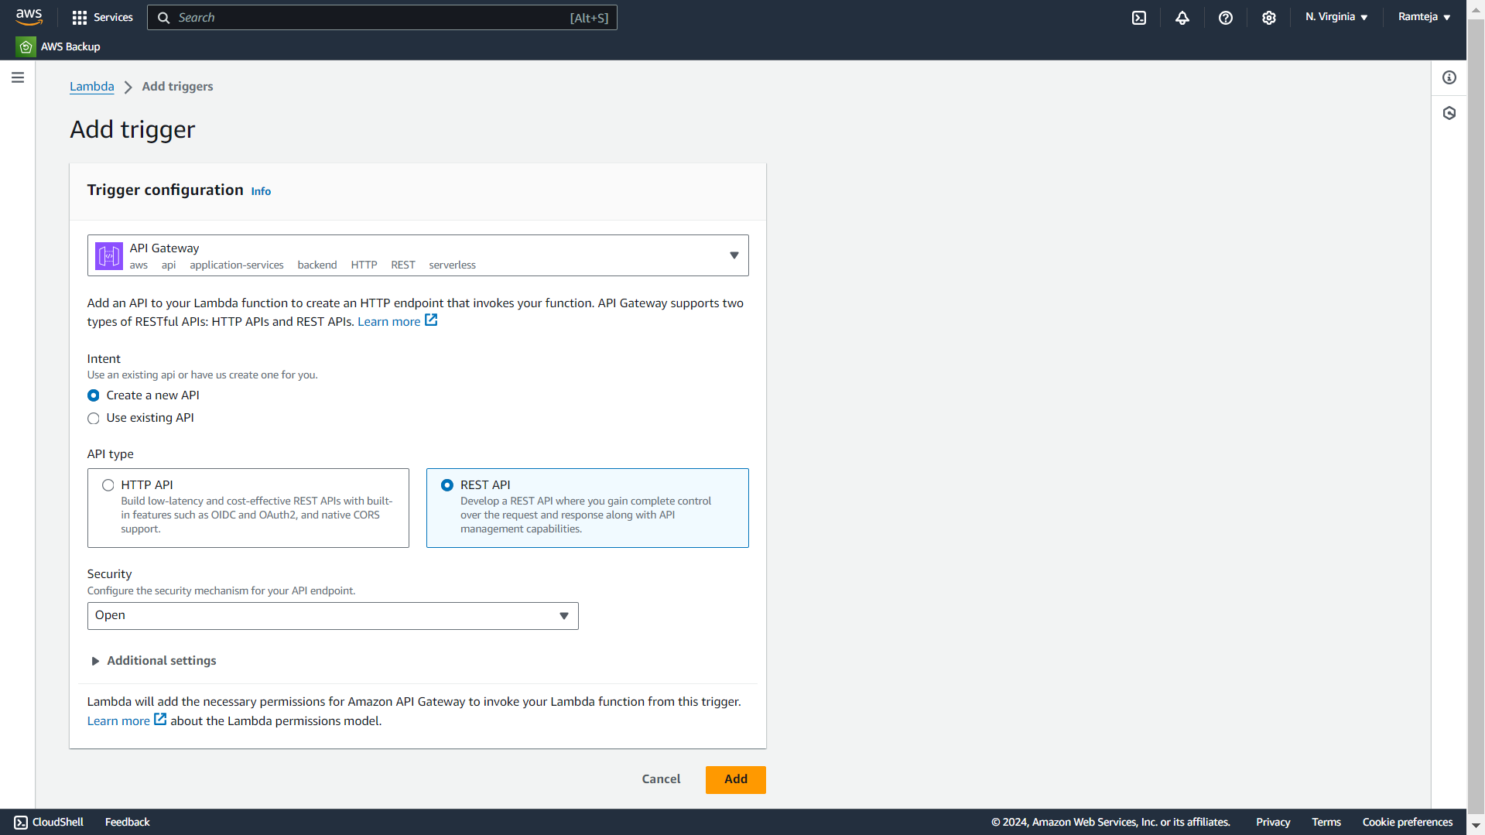
2.1.4 Follow the steps in Setting UpLambda.

Slide 15
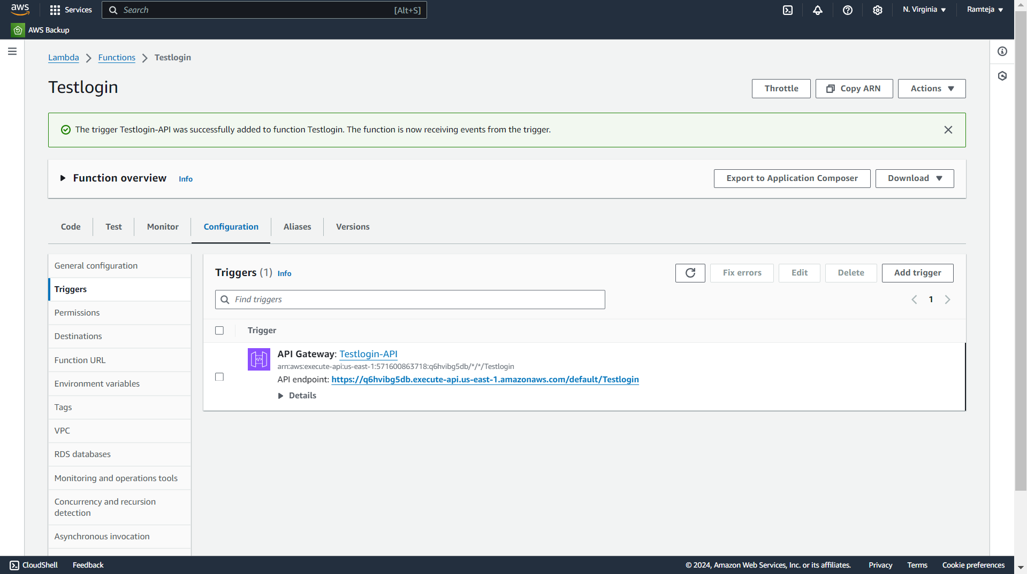
2.1.5 Open Configuration in Lambda Function to Copy API Endpoint URL.

Slide 16
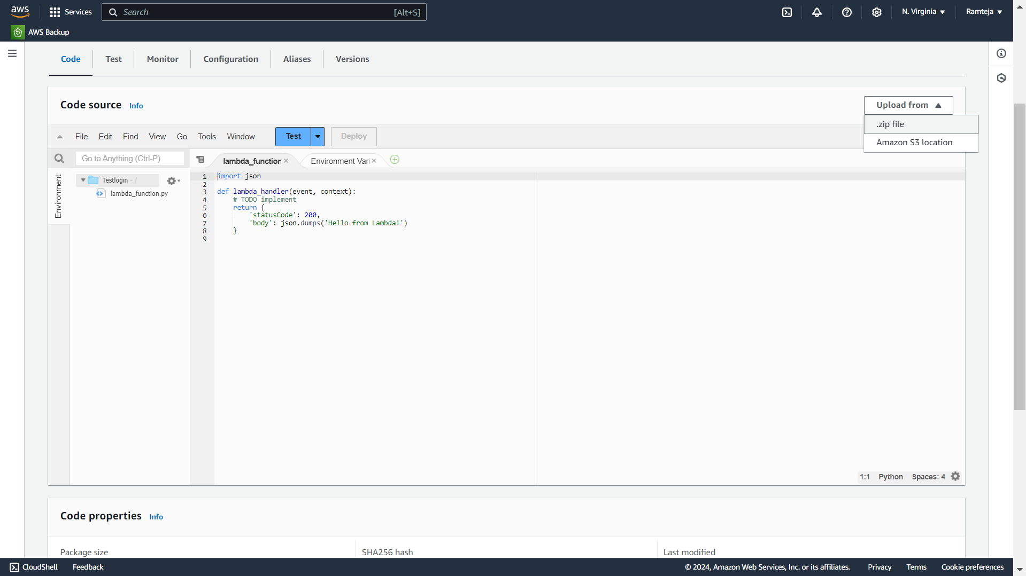
2.1.6 Upload the Zip File.

Slide 17
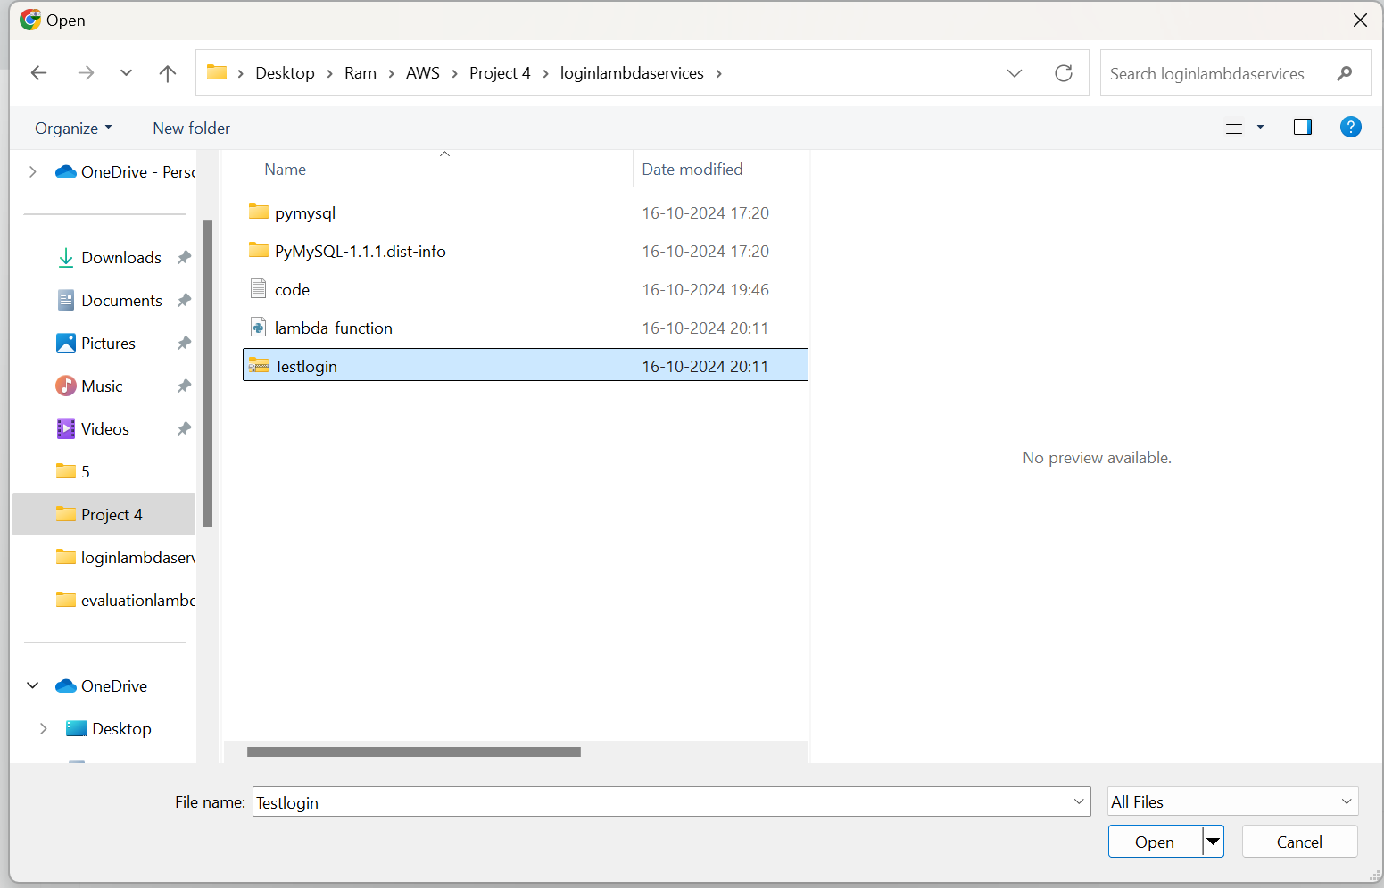
2.1.7 Choose Zip file.

Slide 18
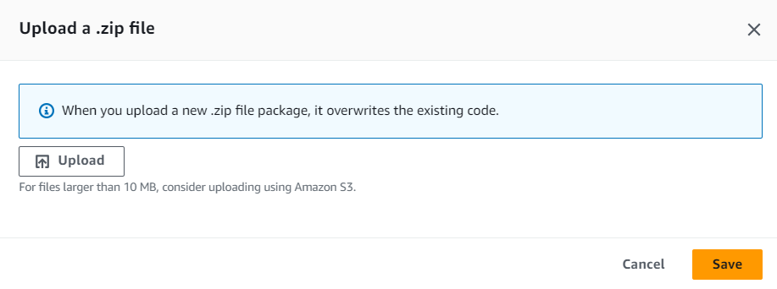
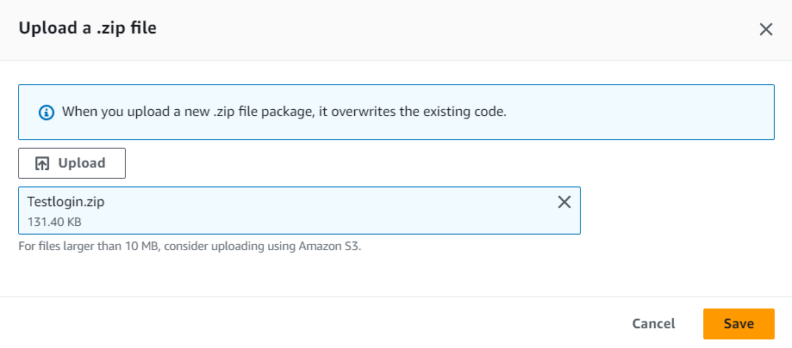

Slide 19
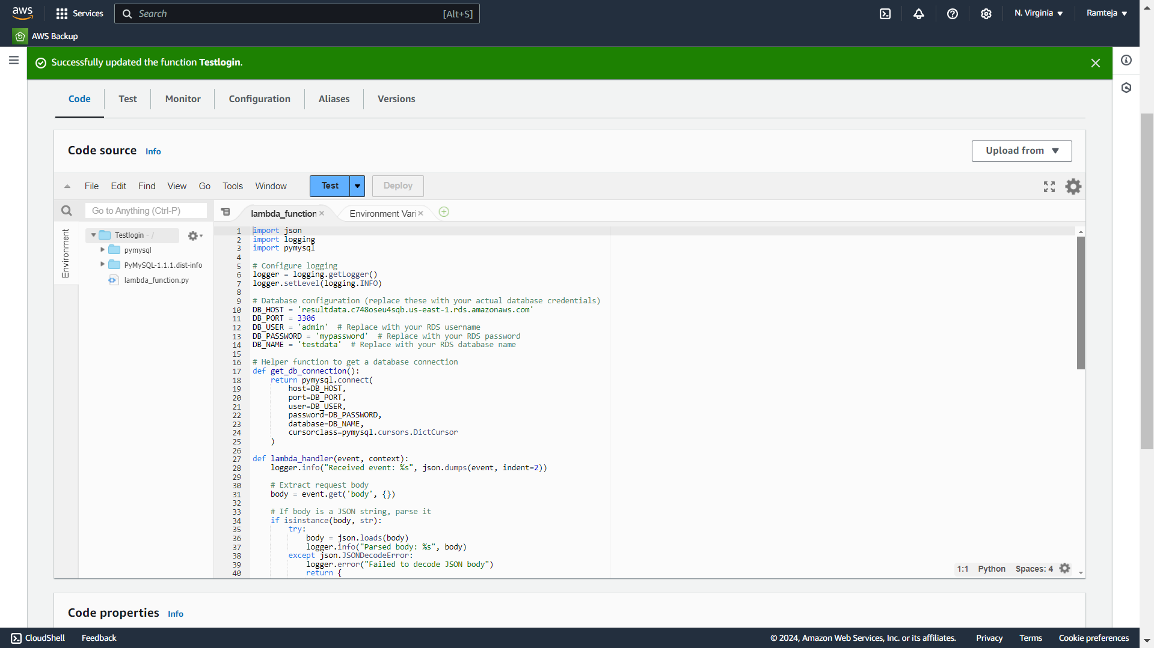
2.1.8 Code Uploaded Successfully.

Slide 20
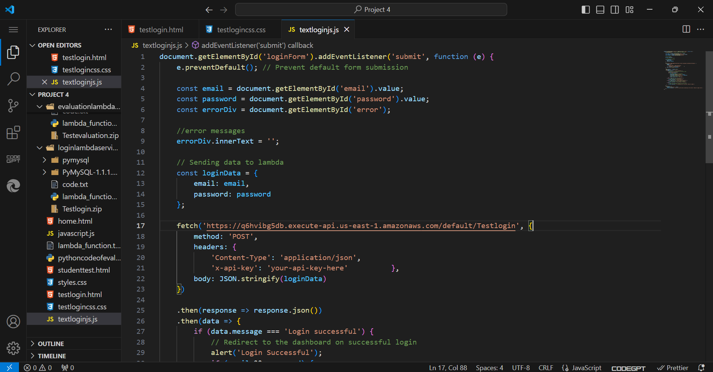
2.1.9 Paste the API Endpoint in JavaScript Code of Testlogin page.

Slide 21
2.2 SettingUp Testevaluation Lambda
Use of Testevaluation Lambda:
1.It is used to take the data of test page from website to AWS Lambda.
2.When the options are selected for the given question by clicking on radio button ,All the selected option of the questions are stored in an selected_options array.
3.It Takes data of email ,password, selected_options , send to AWS lambda when submit button is clicked, the lambda code starts executing.
4.Lambda contains the array of correct answers in it, when these selected_options are sent it evaluates the answers of the Candidate and Calculate Score, Percentage, Pass_Fail_Message that shows candidate is pass or Fail and detail summary of evaluation of all the data in RDS.
5. When the test is submitted, it shows 'Result Stored Successfully' along with the student's result, and all the data is added to RDS. .
6. If a candidate tries to submit again, it won't be possible, and 'Test already submitted' will be displayed.

Slide 22
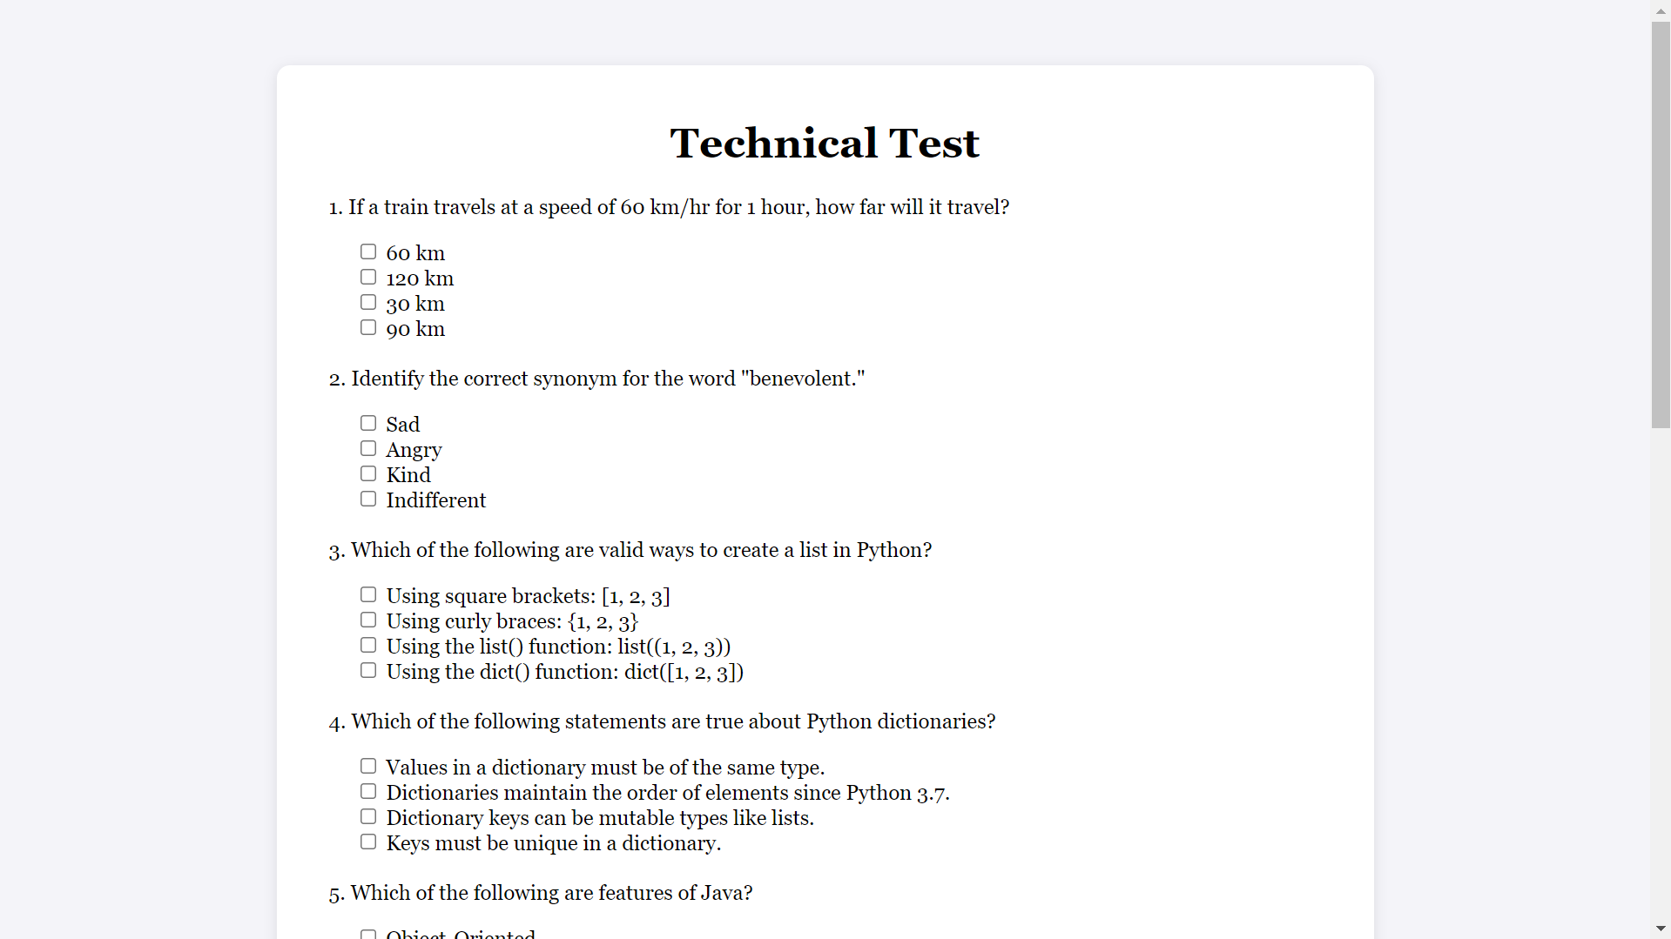
Test Page

Slide 23
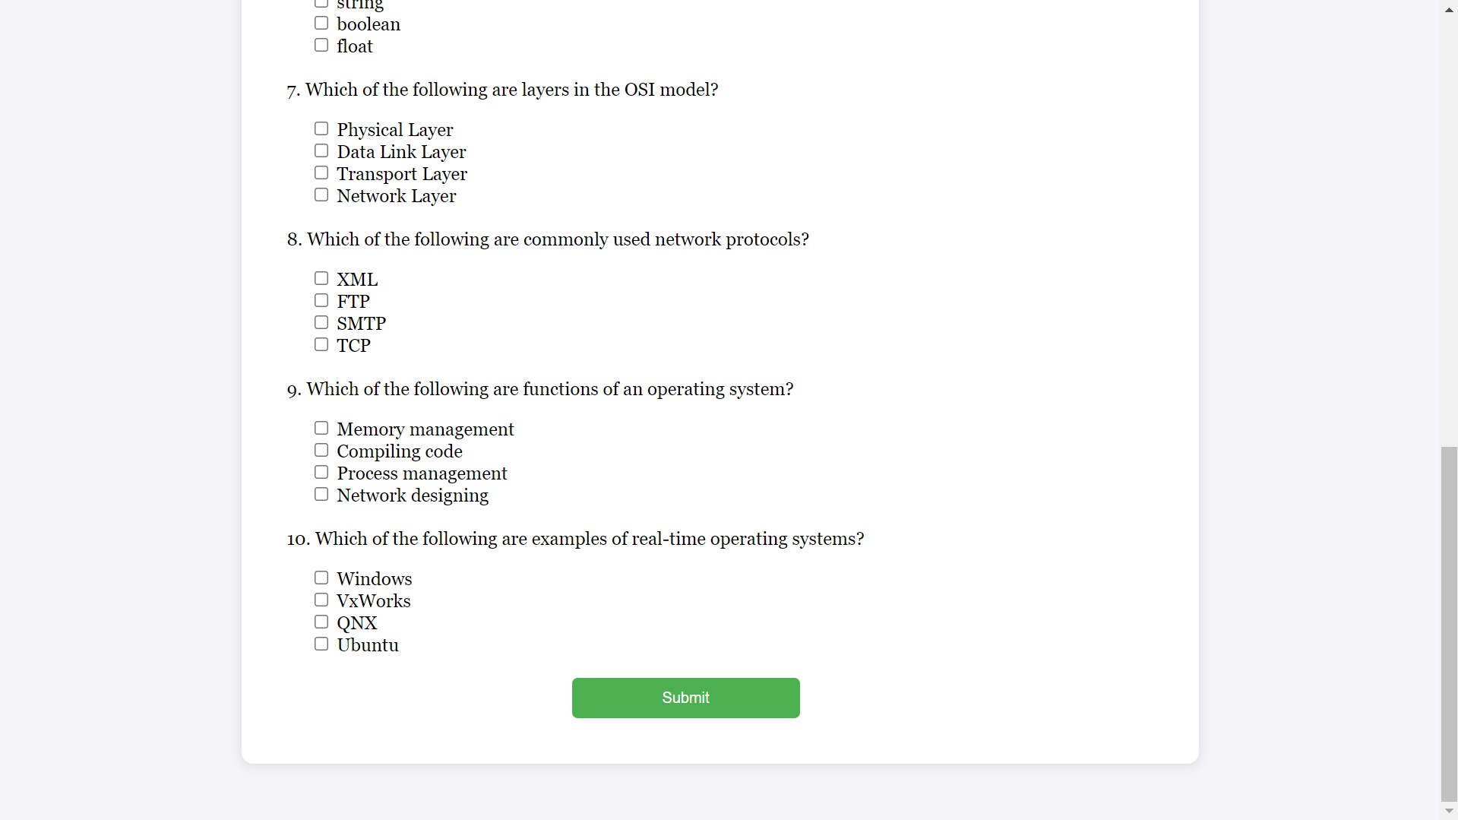
Test Page 2

Slide 24
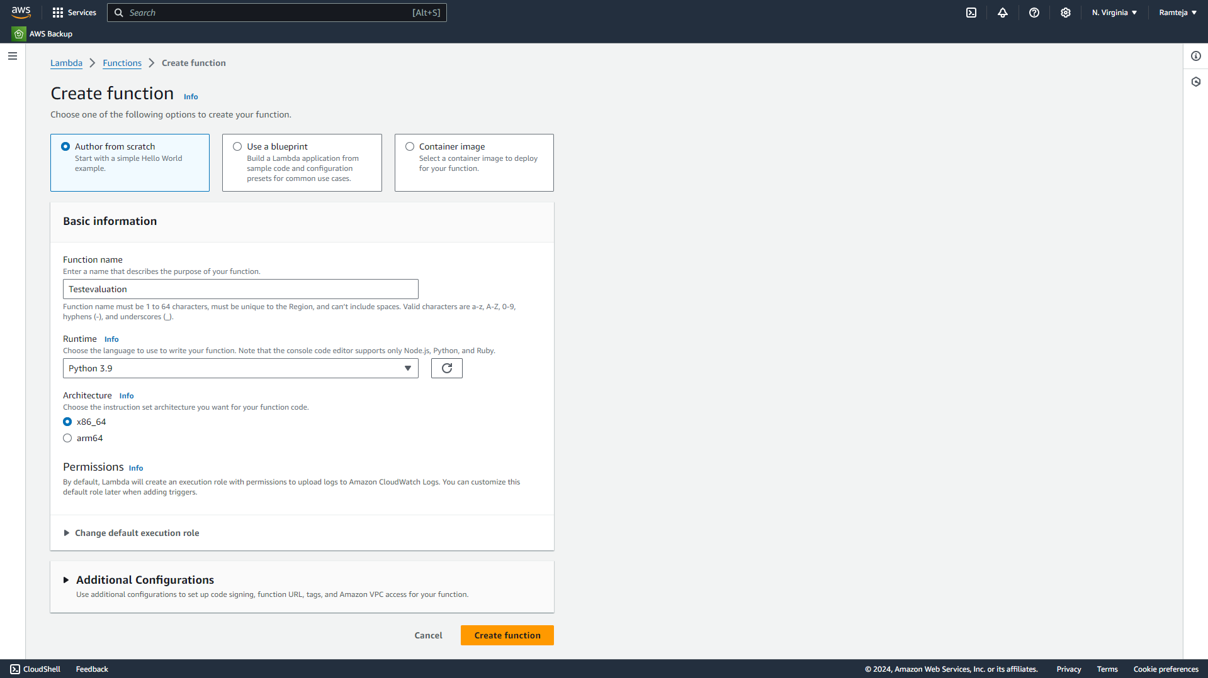
2.2.1 Create lambda function for Test page.

Slide 25
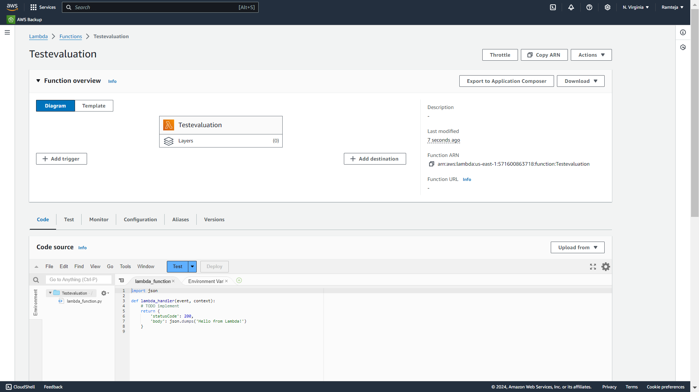
2.2.2 Lambda function “Testevaluation” is Created, Click on Add trigger.

Slide 26
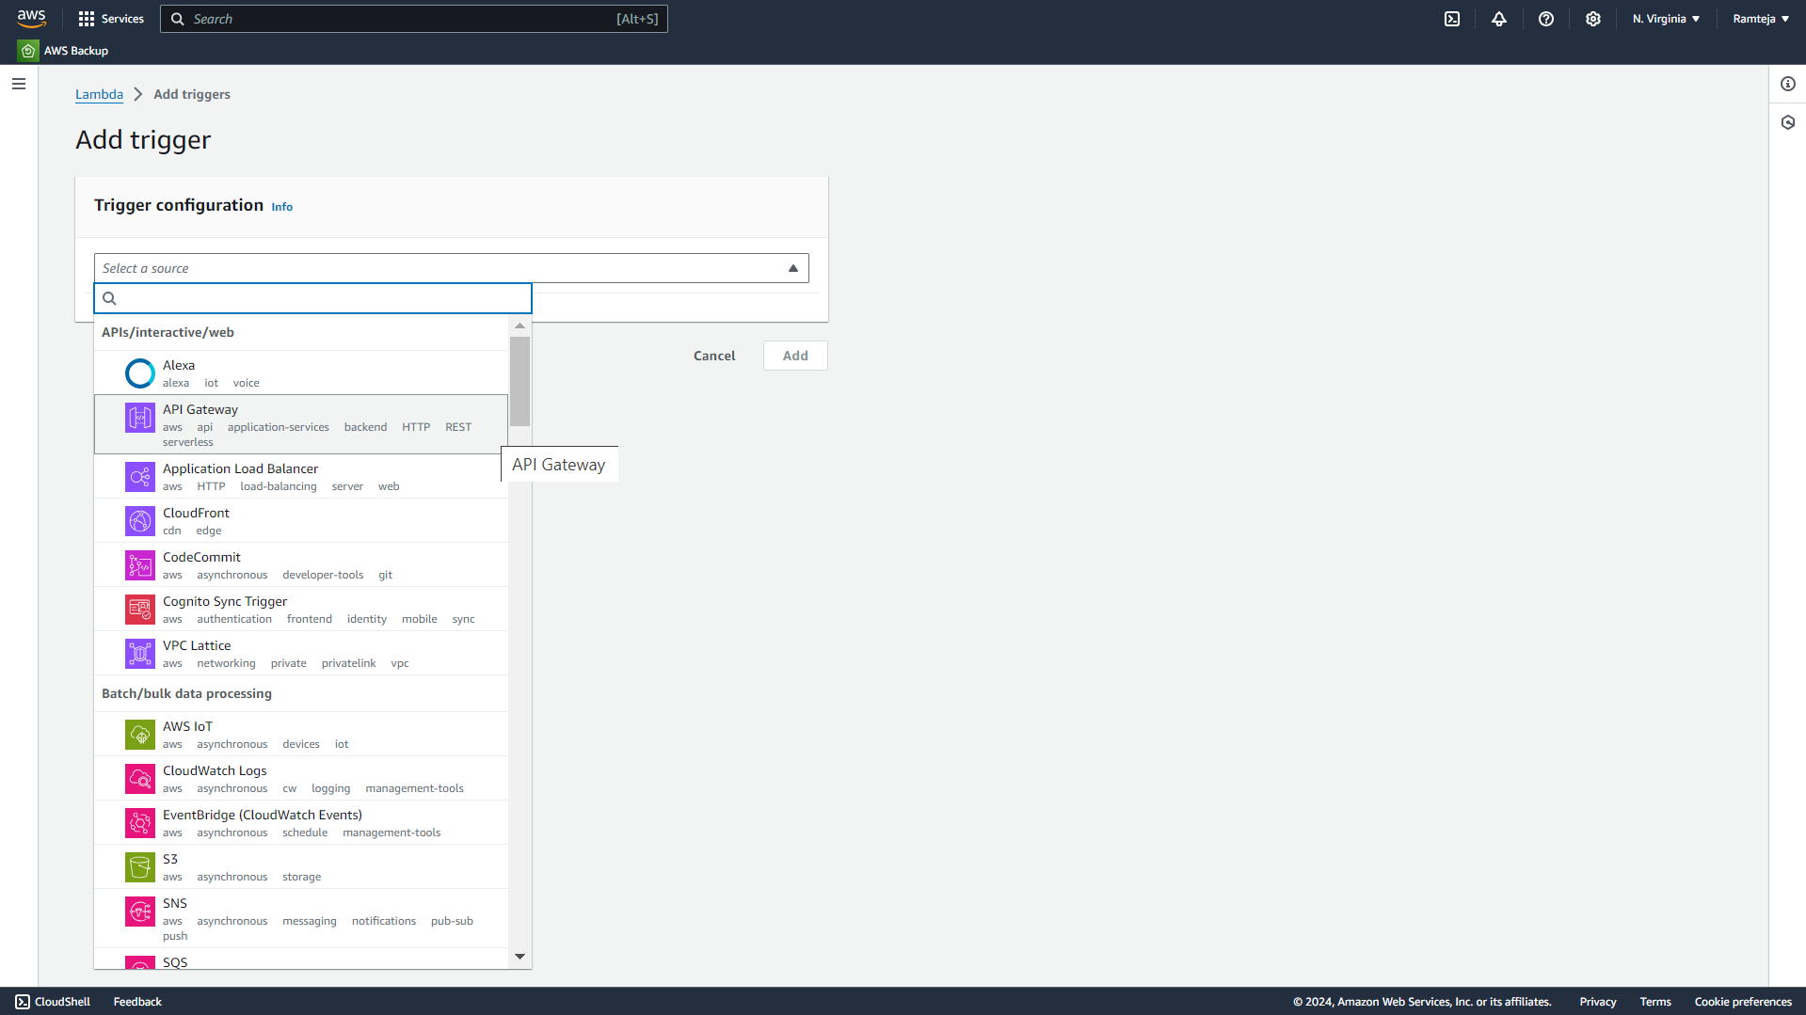
2.2.3 Select the API Gateway in Trigger Configuration.

Slide 27
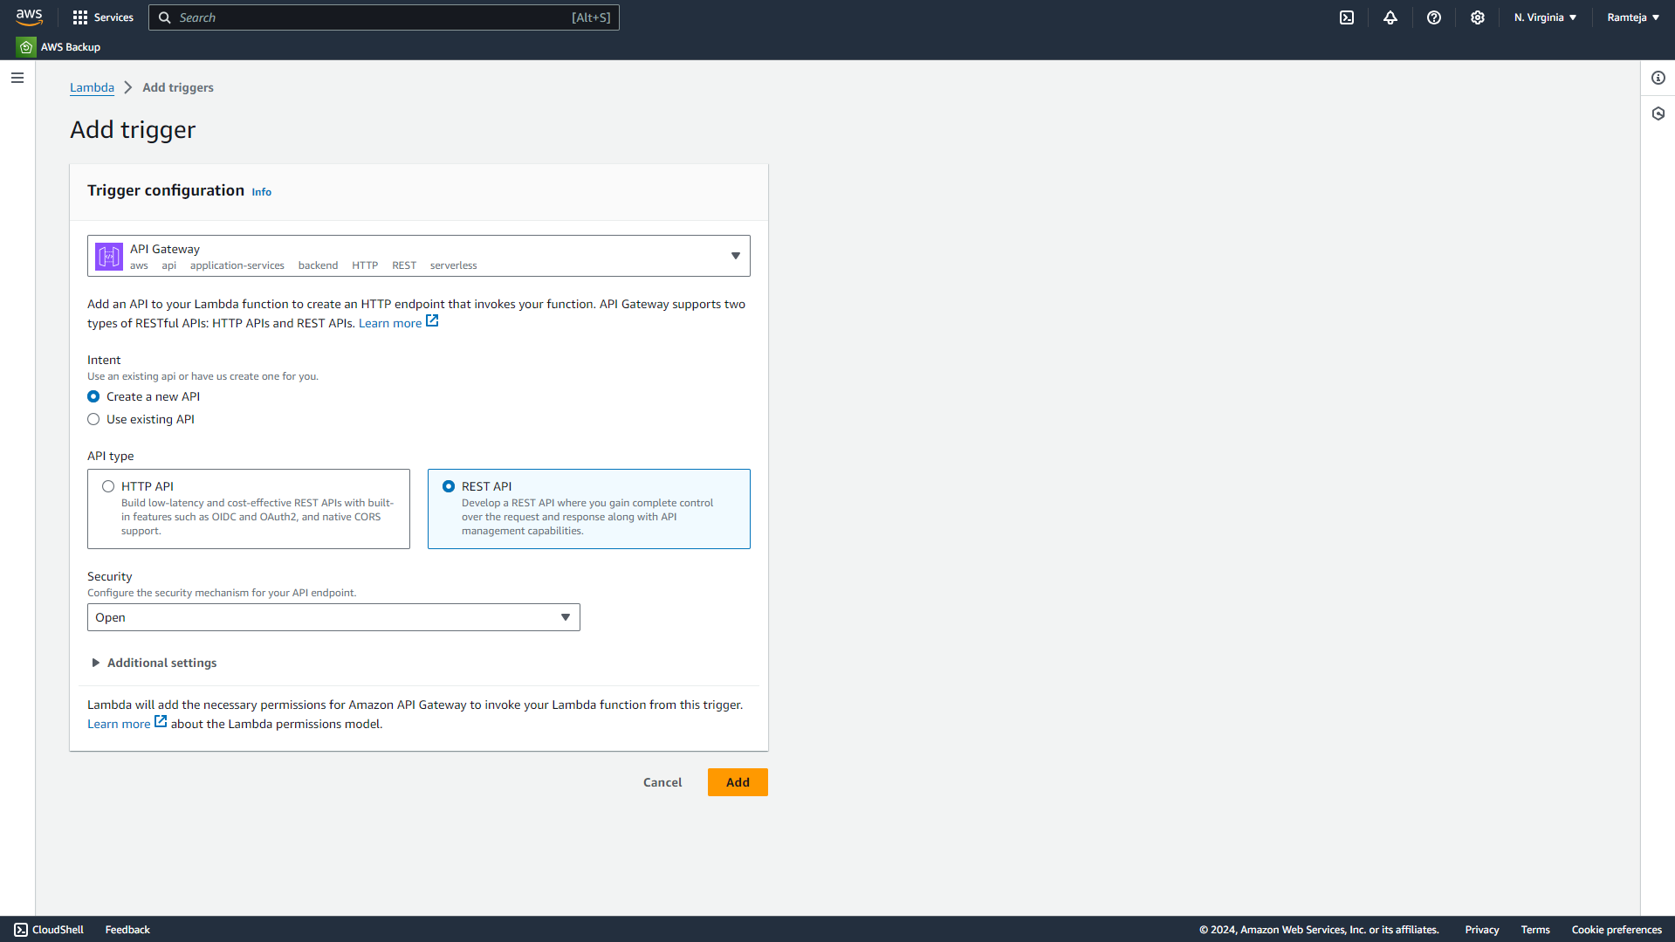
2.2.4 Follow the steps in Setting UpLambda.

Slide 28
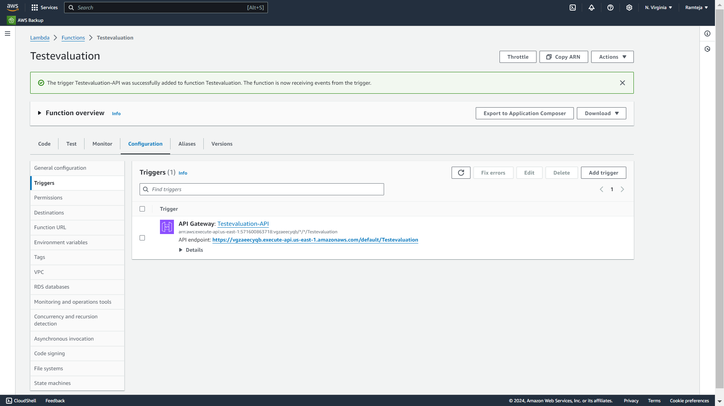
2.2.5 Open Configuration in Lambda Function to Copy API Endpoint URL.

Slide 29
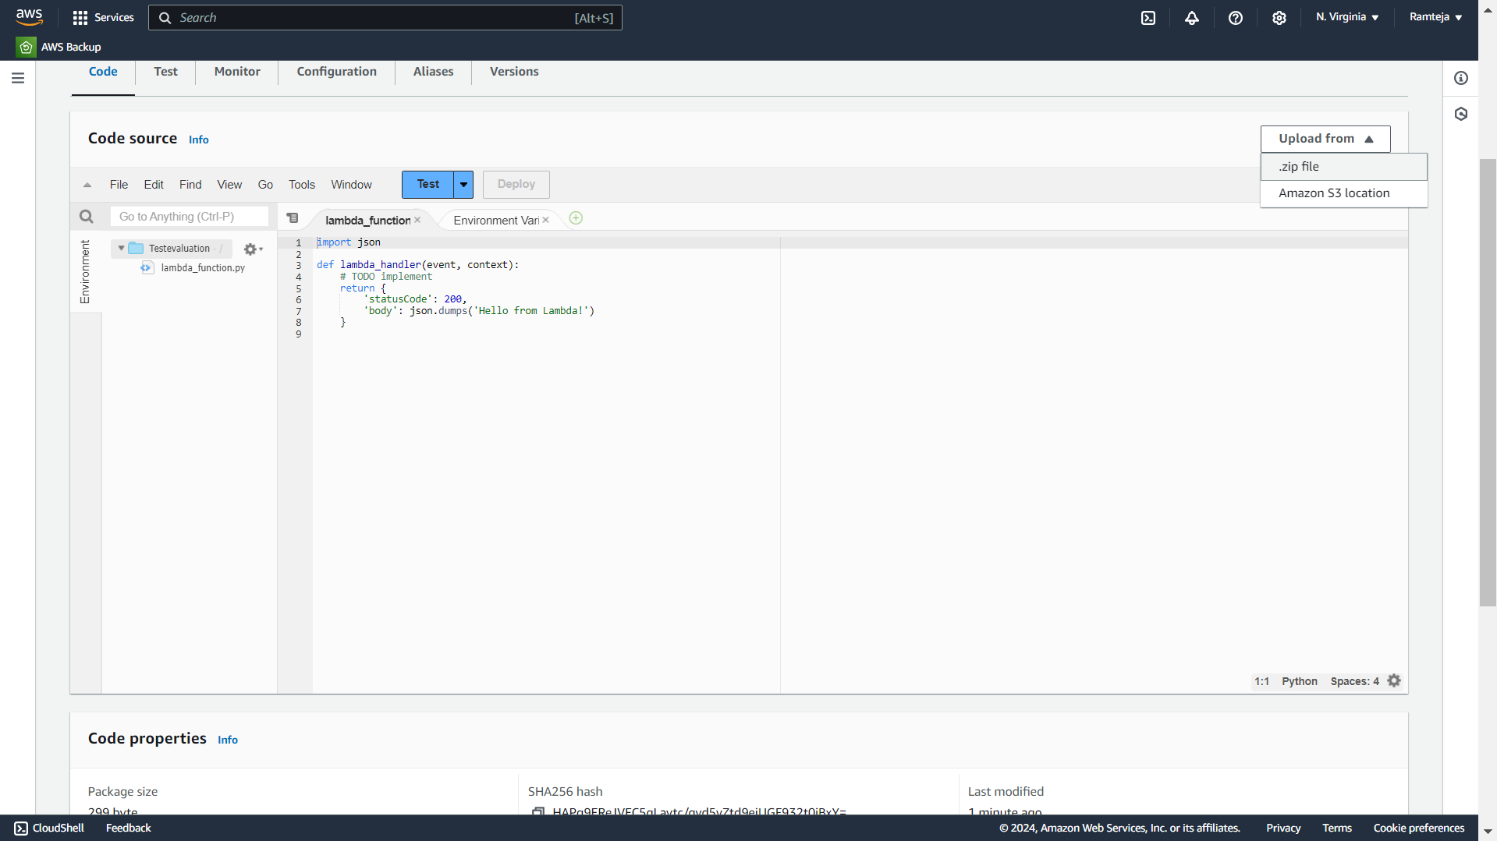
2.2.6 Upload the Zip File.

Slide 30
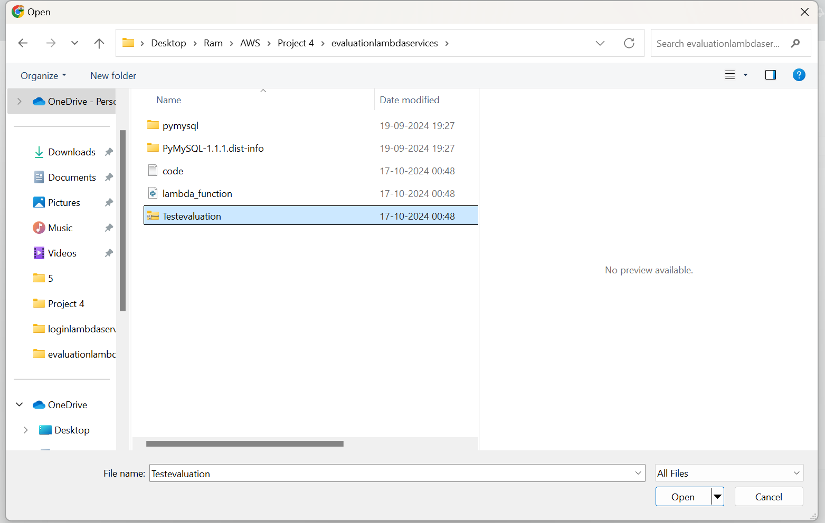
2.2.7 Choose Zip file.

Slide 31
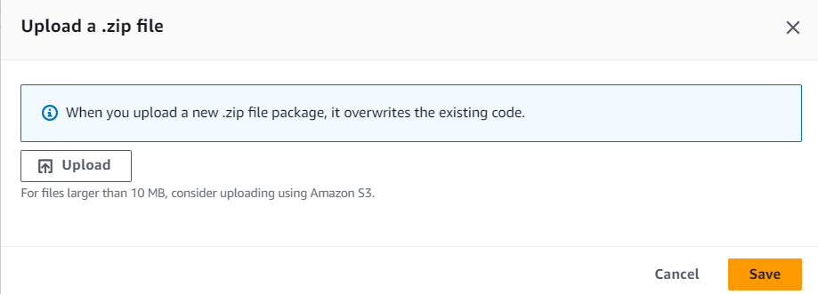
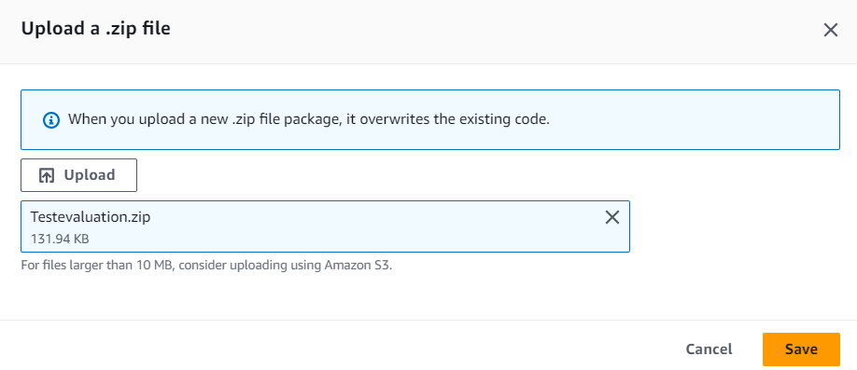

Slide 32
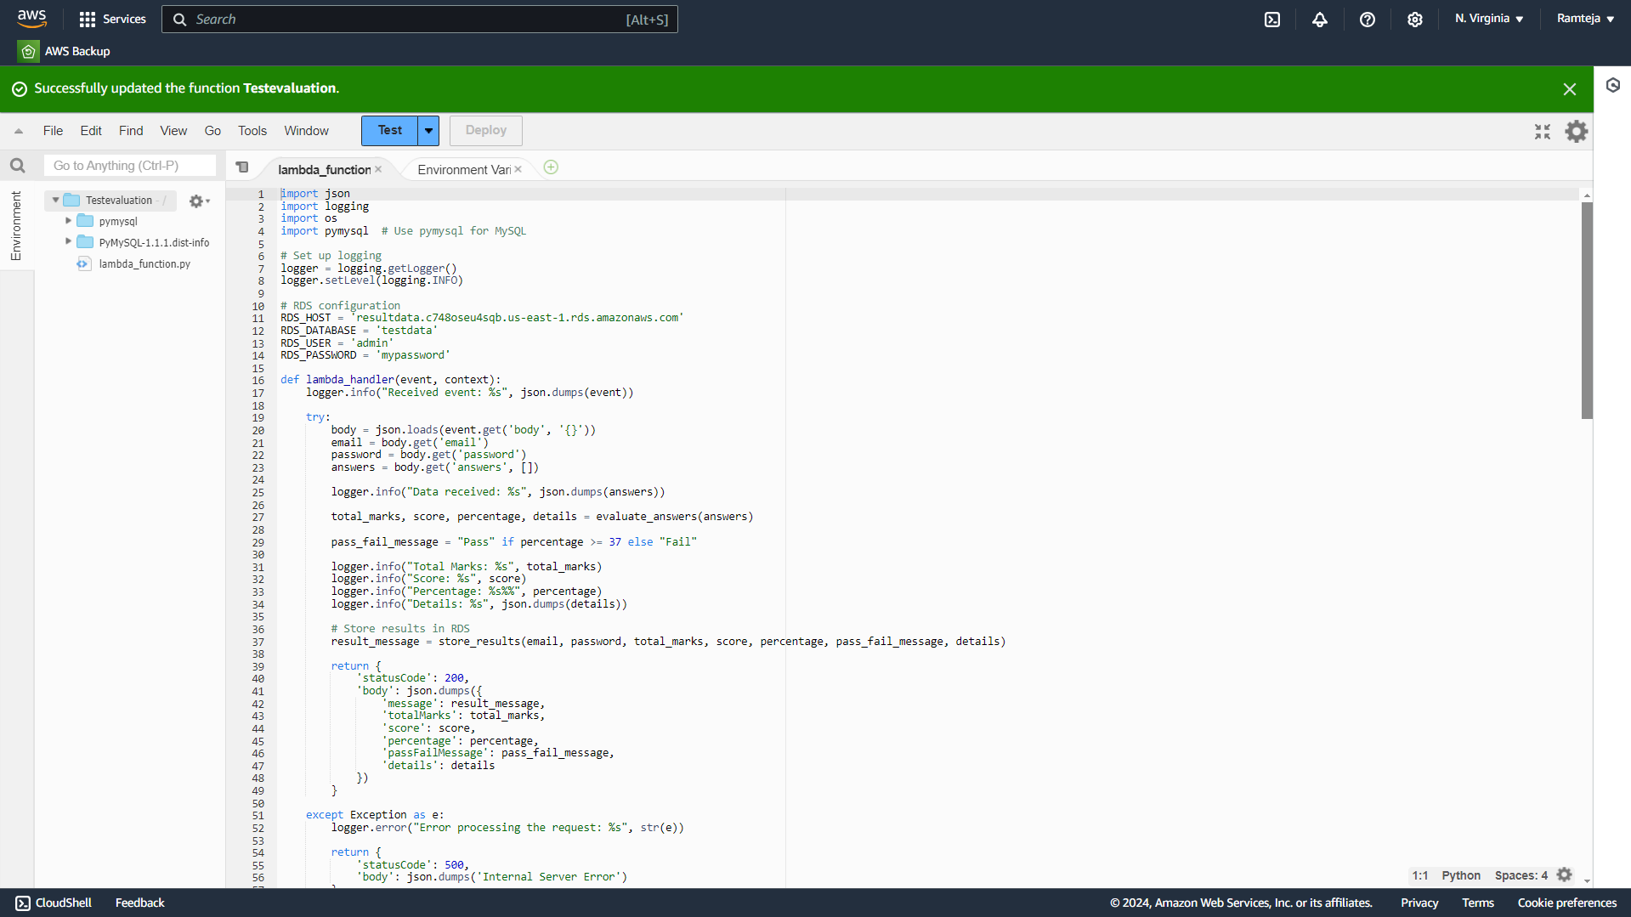
2.2.8 Code Uploaded Successfully.

Slide 33
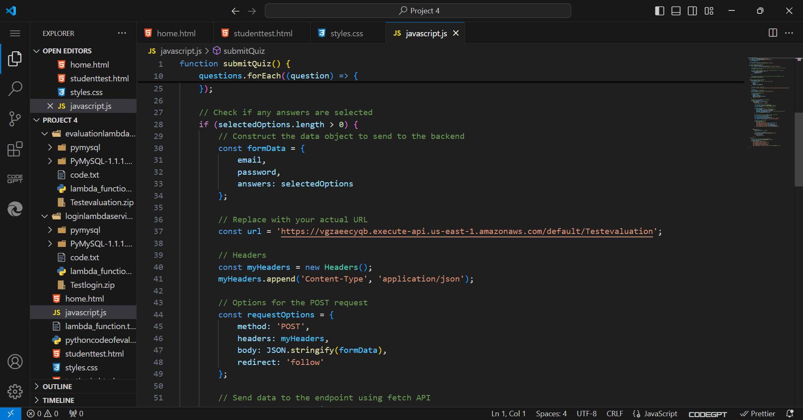
2.2.9 Paste the API Endpoint in JavaScript Code of Test page.

Slide 34
3.SettingUp S3 for Hosting
1.Search for S3 in Search bar and open S3 dashboard, Click on Create Bucket.
2.Select the bucket type as General Purpose, Give Unique bucket name to your bucket.
3.Checkmark on Block All public Access, Select ACL’s disable in Object Ownership & Click on Create Bucket.
4. Select the S3 Bucket ,Click on Objects ,Click on Upload & Choose the files from your PC.
5.Click on file to be uploaded (Html CSS JS) and Click on Upload.
6.When we use the Object URL of this file in S3 bucket it will be only available for your Private users.
7.If the Public Users wants to access the website.
8.Select the file in S3 bucket ,Click on permissions, Uncheck mark the “Block all public access” to convert into Public ,Copy the Bucket ARN number & Click on Edit on Bucket Policy.

Slide 35
9.Select S3 bucket policy in Select Policy type ,Click on Allow Effects & Type * in Principles.
10.Check mark All Actions , Paste the Bucket ARN and enter /* after Bucket ARN.
11.Click On Add Statement & Click on Generate Policy.
12.Copy the code from AWS Policy and Paste it in Bucket Policy & Save it.
13.Bucket Policy edited Successfully.
14. Now public users can access our website by Object URL.

Slide 36
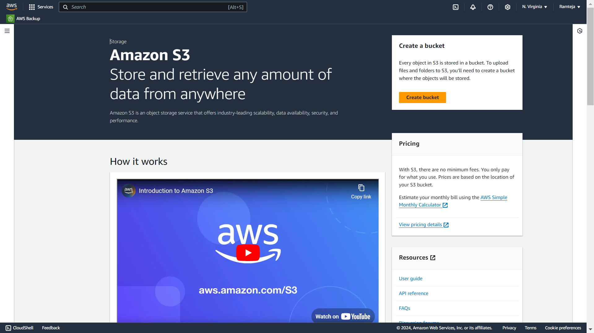
3.1 Click On Create Bucket.

Slide 37
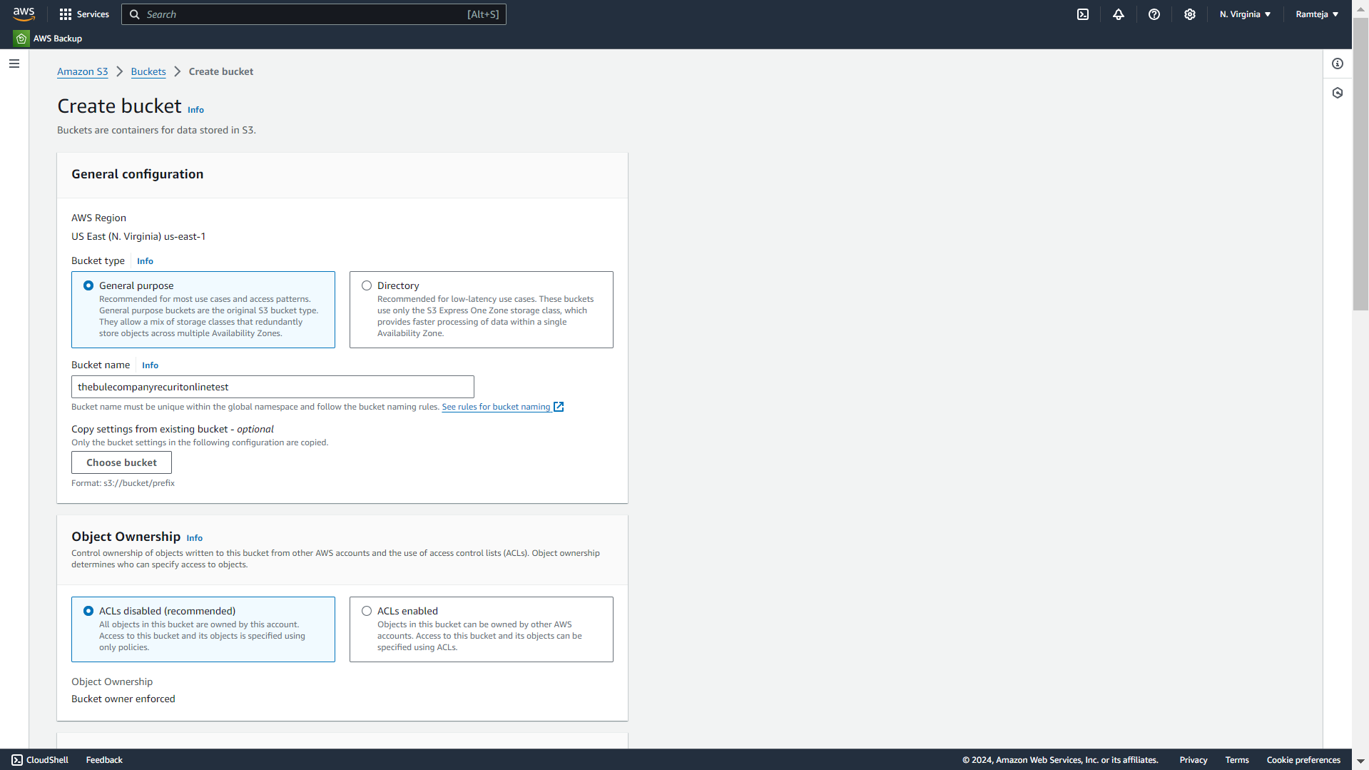
3.2 Give Unique Name for your Bucket.

Slide 38
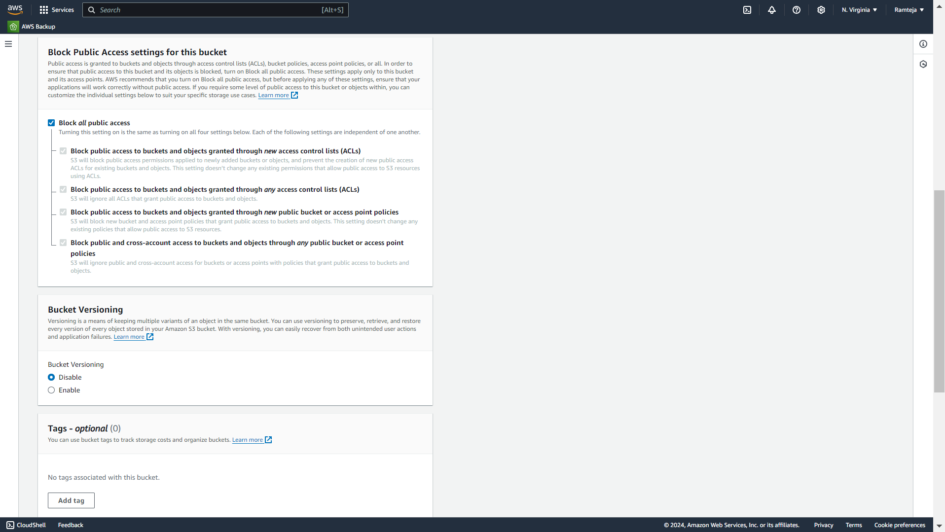
3.3 Make Sure that the Checkmark is ticked in Block all public access.

Slide 39
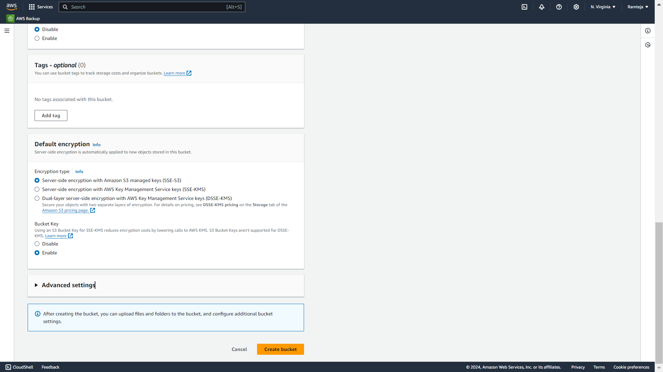
3.4 Click on Create bucket.

Slide 40
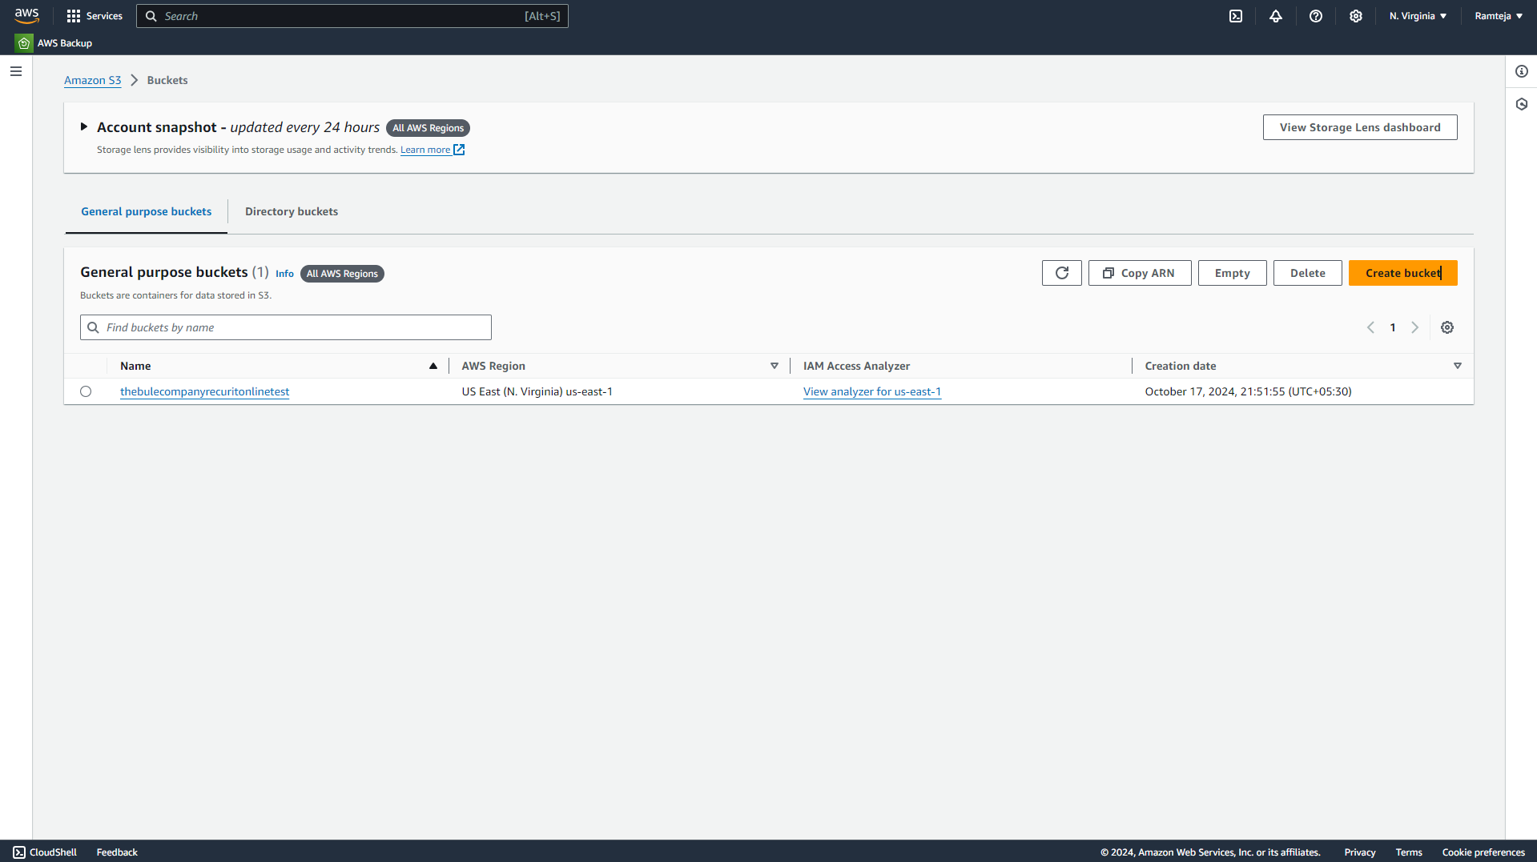
3.5 Bucket Created Successfully & Open the bucket.

Slide 41
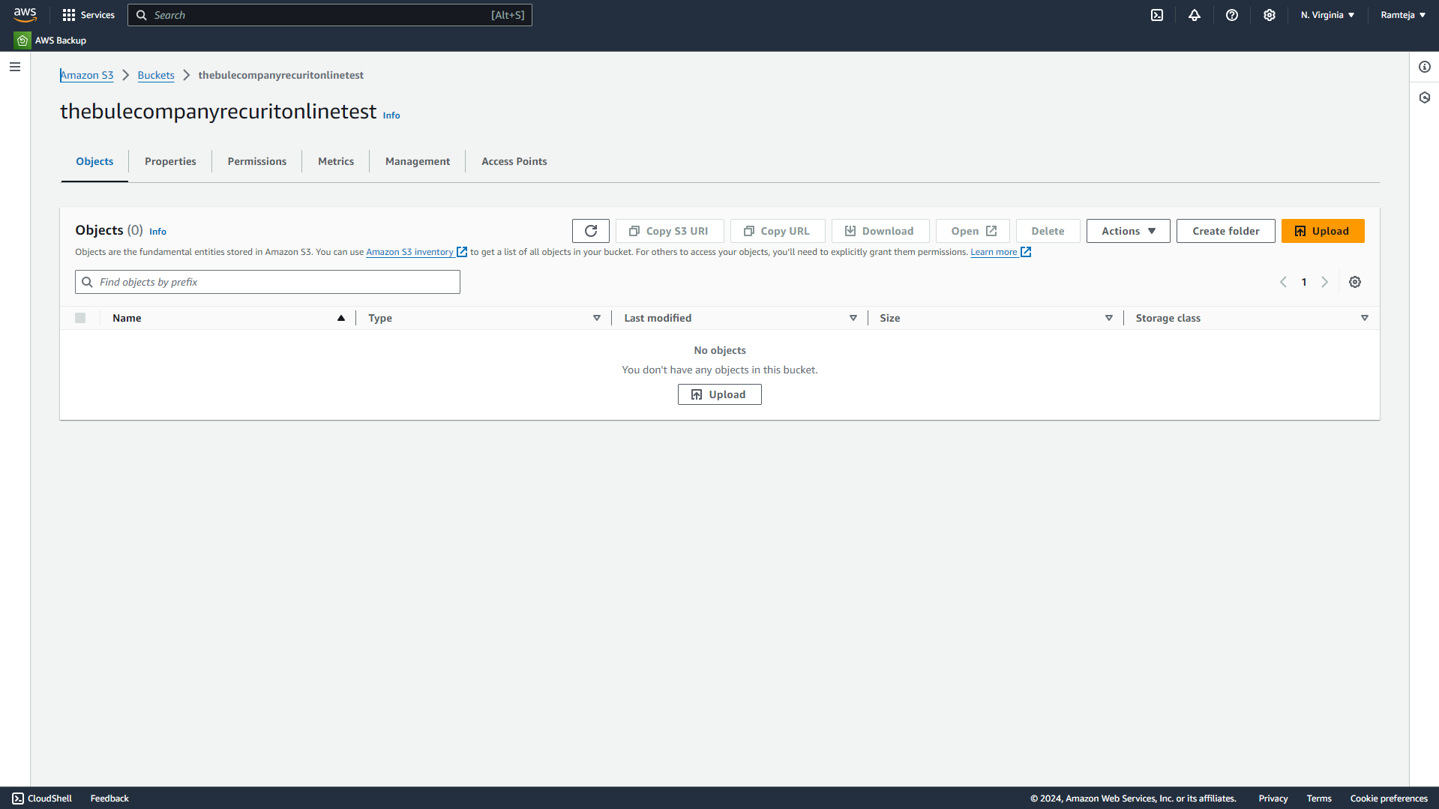
3.6 Click on Upload to add files in bucket.

Slide 42
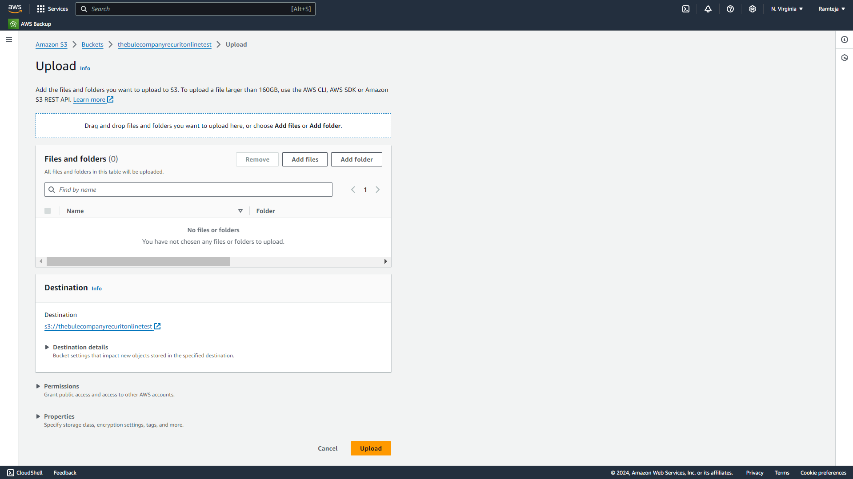
3.7 Select Files from PC & Click Upload.

Slide 43
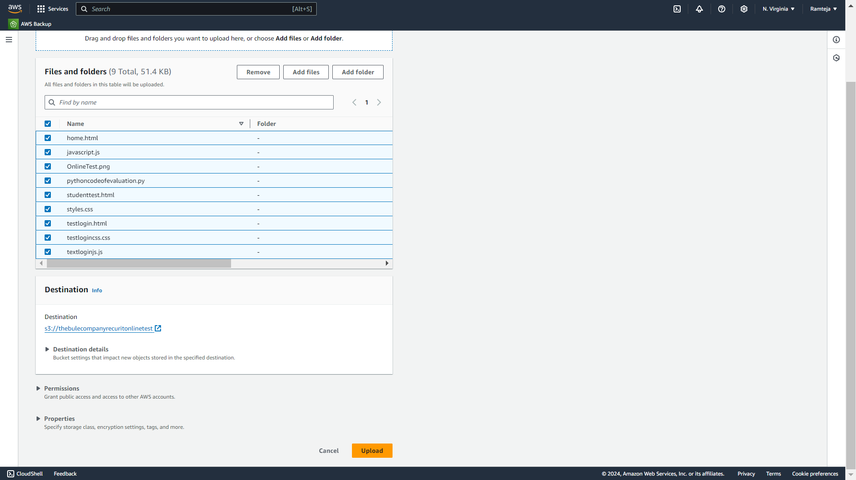
3.8 Select all Files & Click Upload.

Slide 44
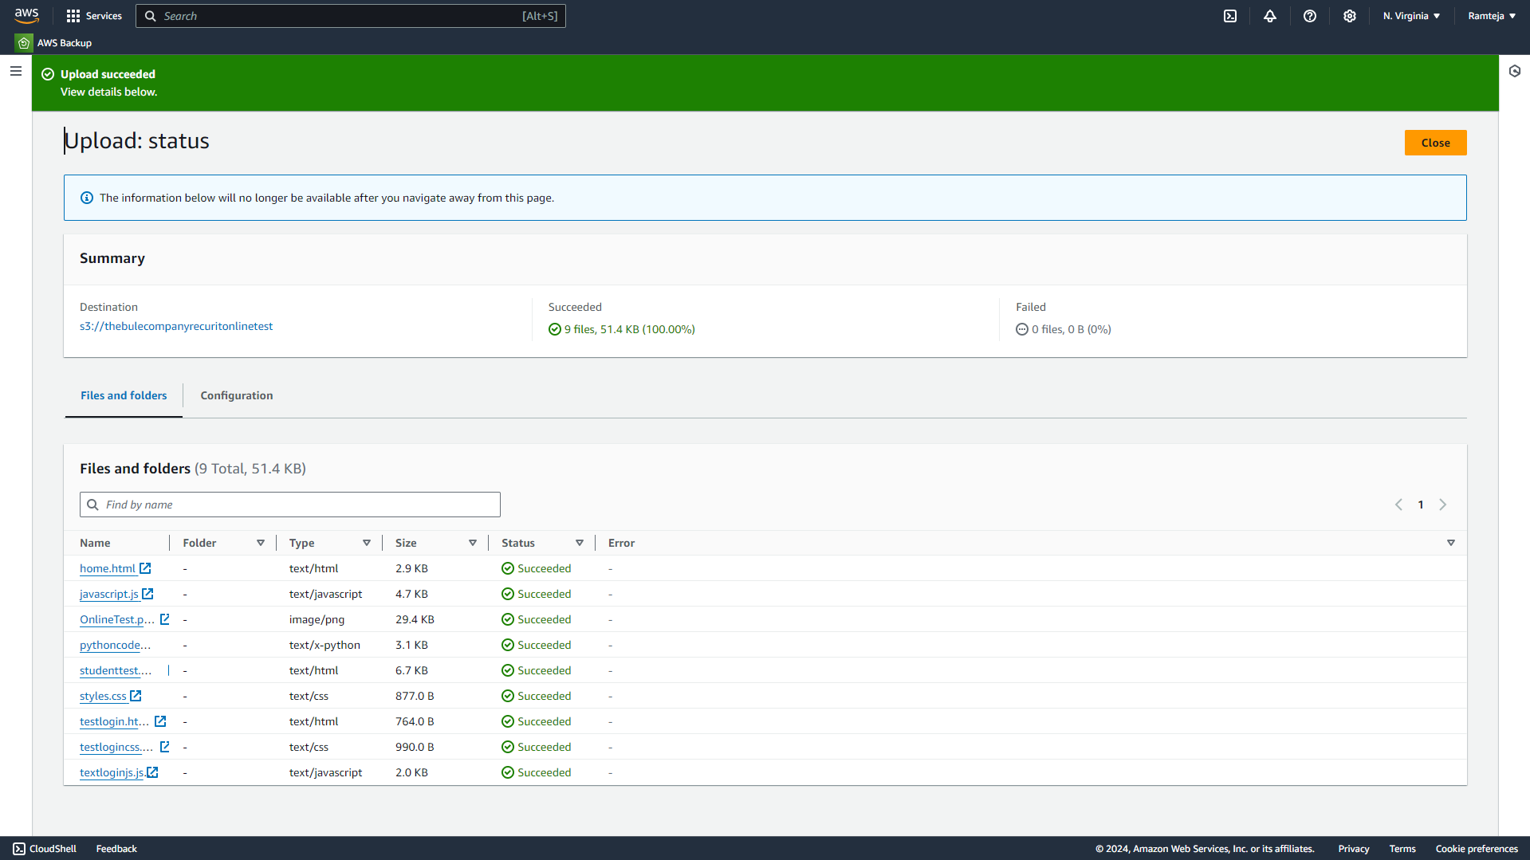
3.9 Objects in S3 bucket added Successfully.

Slide 45
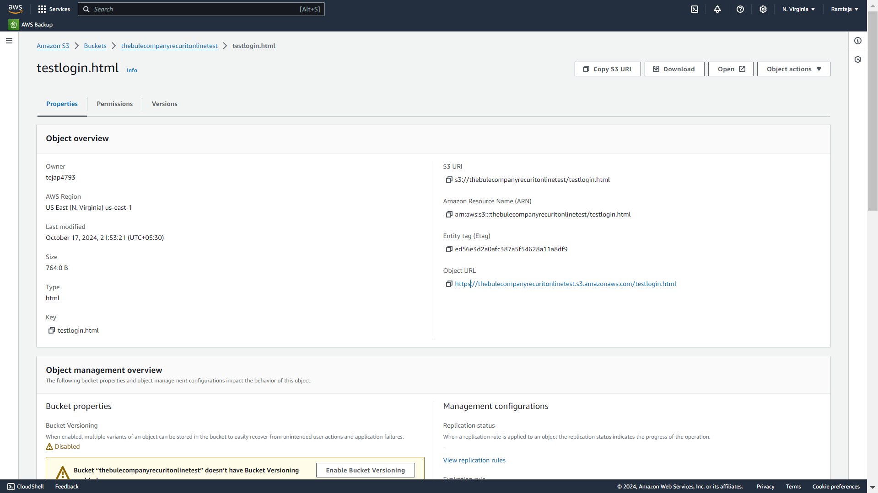
3.10 Copy the Object URL of testlogin.html to share everyone.

Slide 46
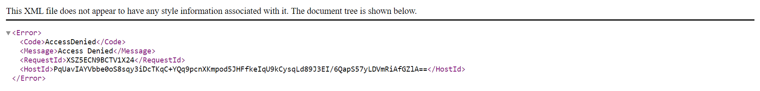
3.11 The bucket is private so link will not work.

Slide 47
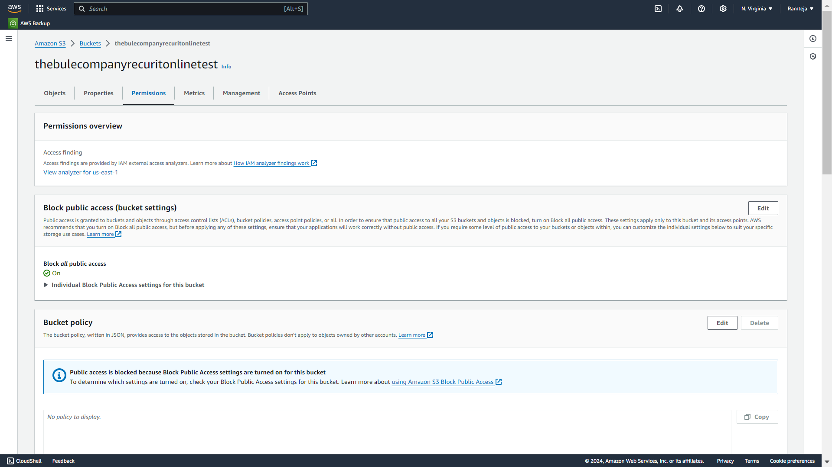
3.12 Click on Edit in Block Public Access.

Slide 48
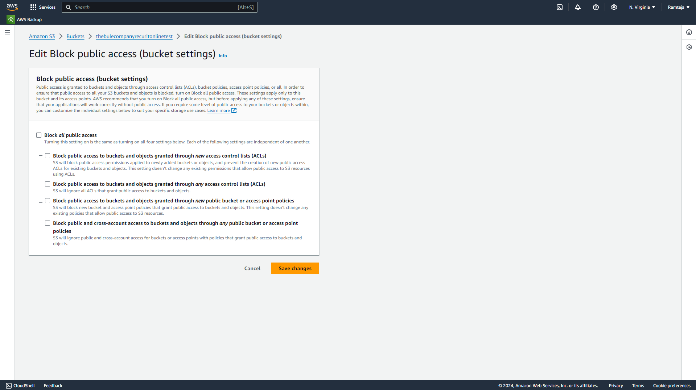
3.13 Uncheck the Block all public access.

Slide 49
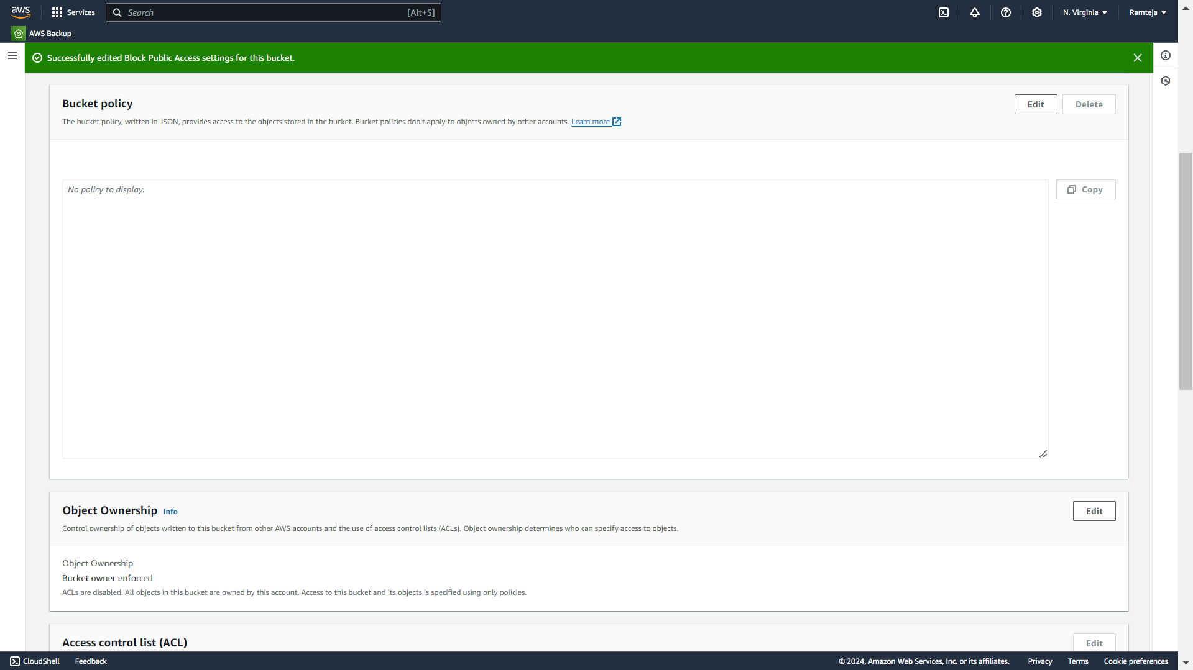
3.14 Click on Edit in Bucket Policy.

Slide 50
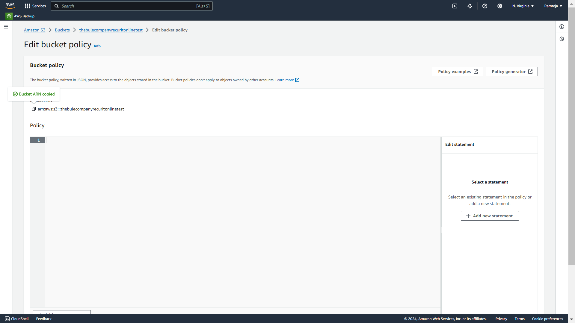
3.15 Copy the Bucket ARN & Click on Policy Generator.

Slide 51
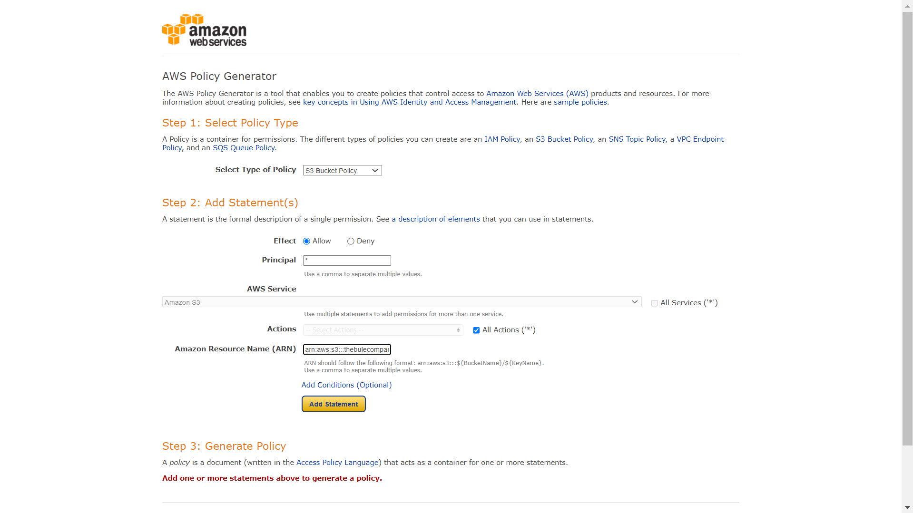
3.16 Create a New Policy Generator.

Slide 52
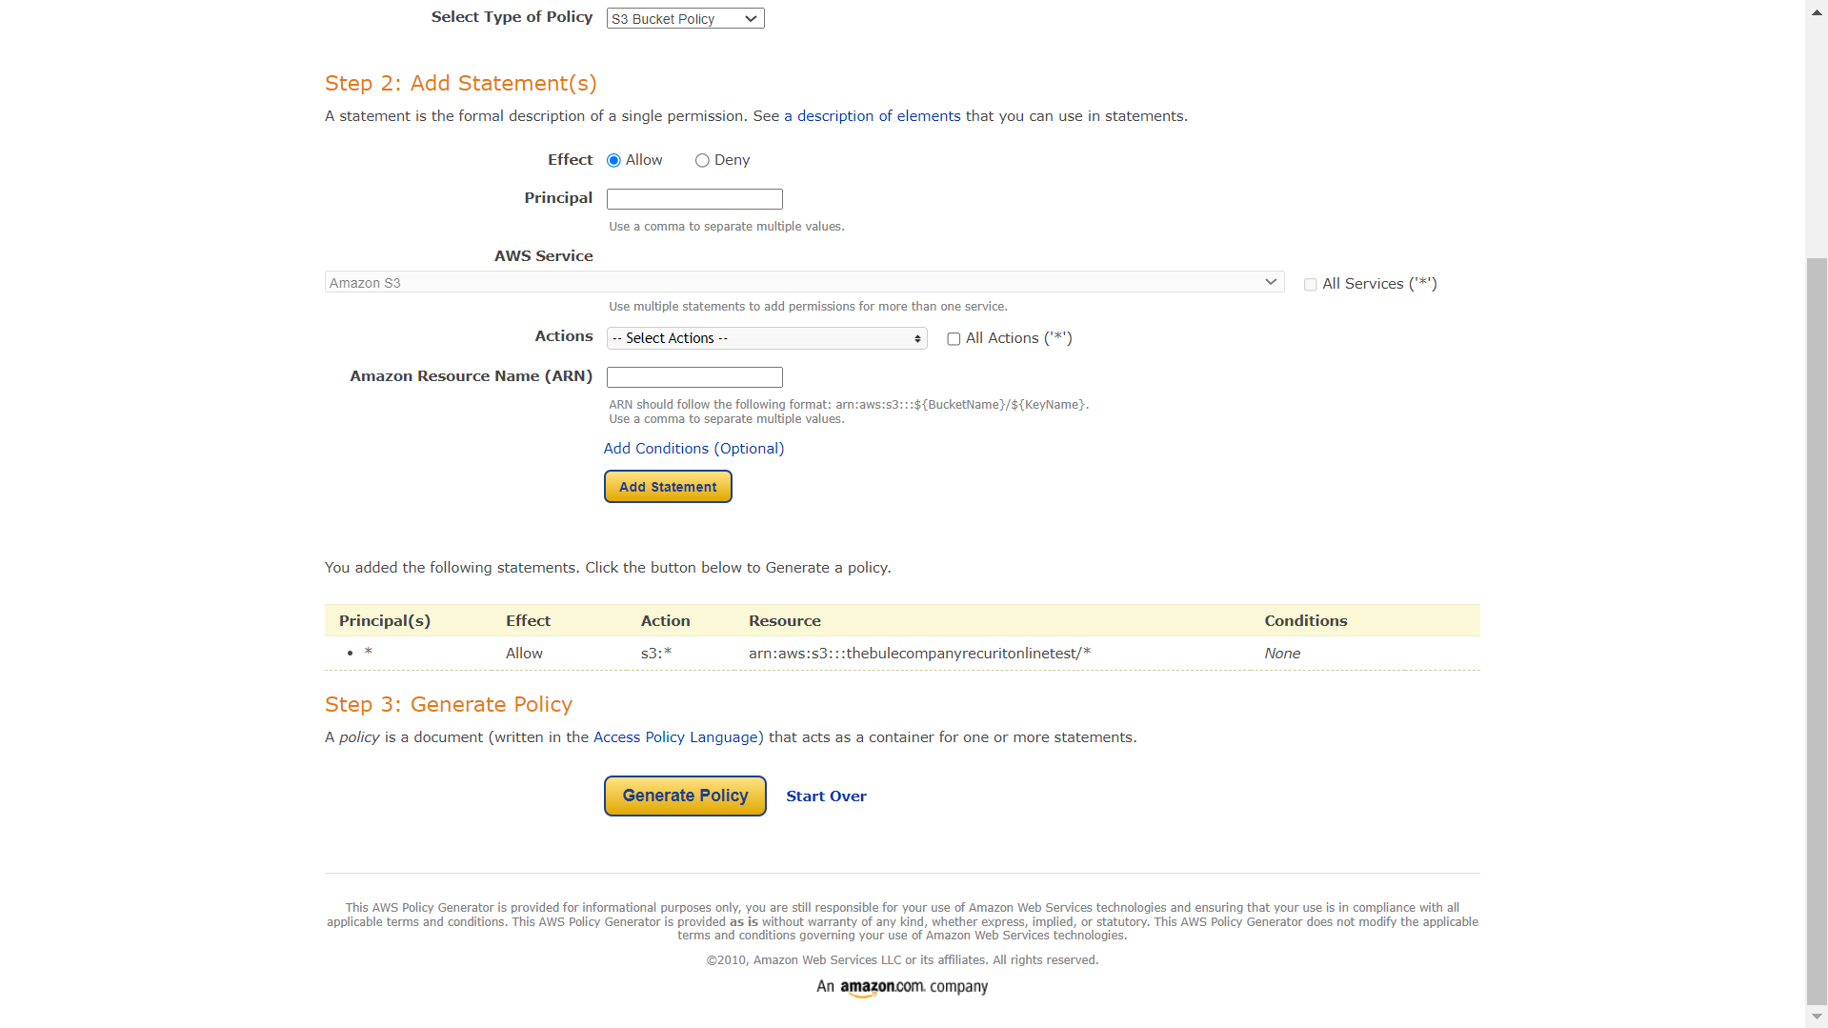
3.17 Follow the steps in SettingUp S3.

Slide 53
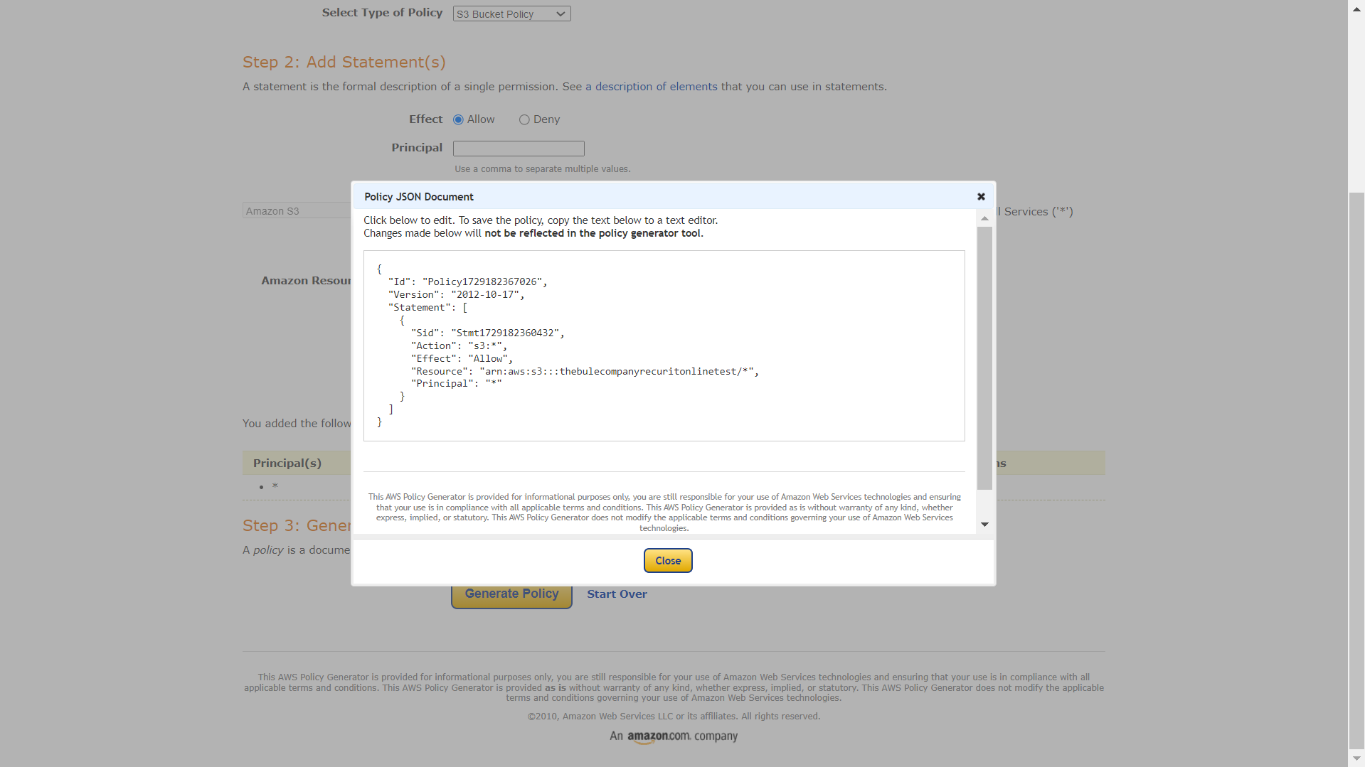
3.18 Click on Generate Policy & Copy the code.

Slide 54
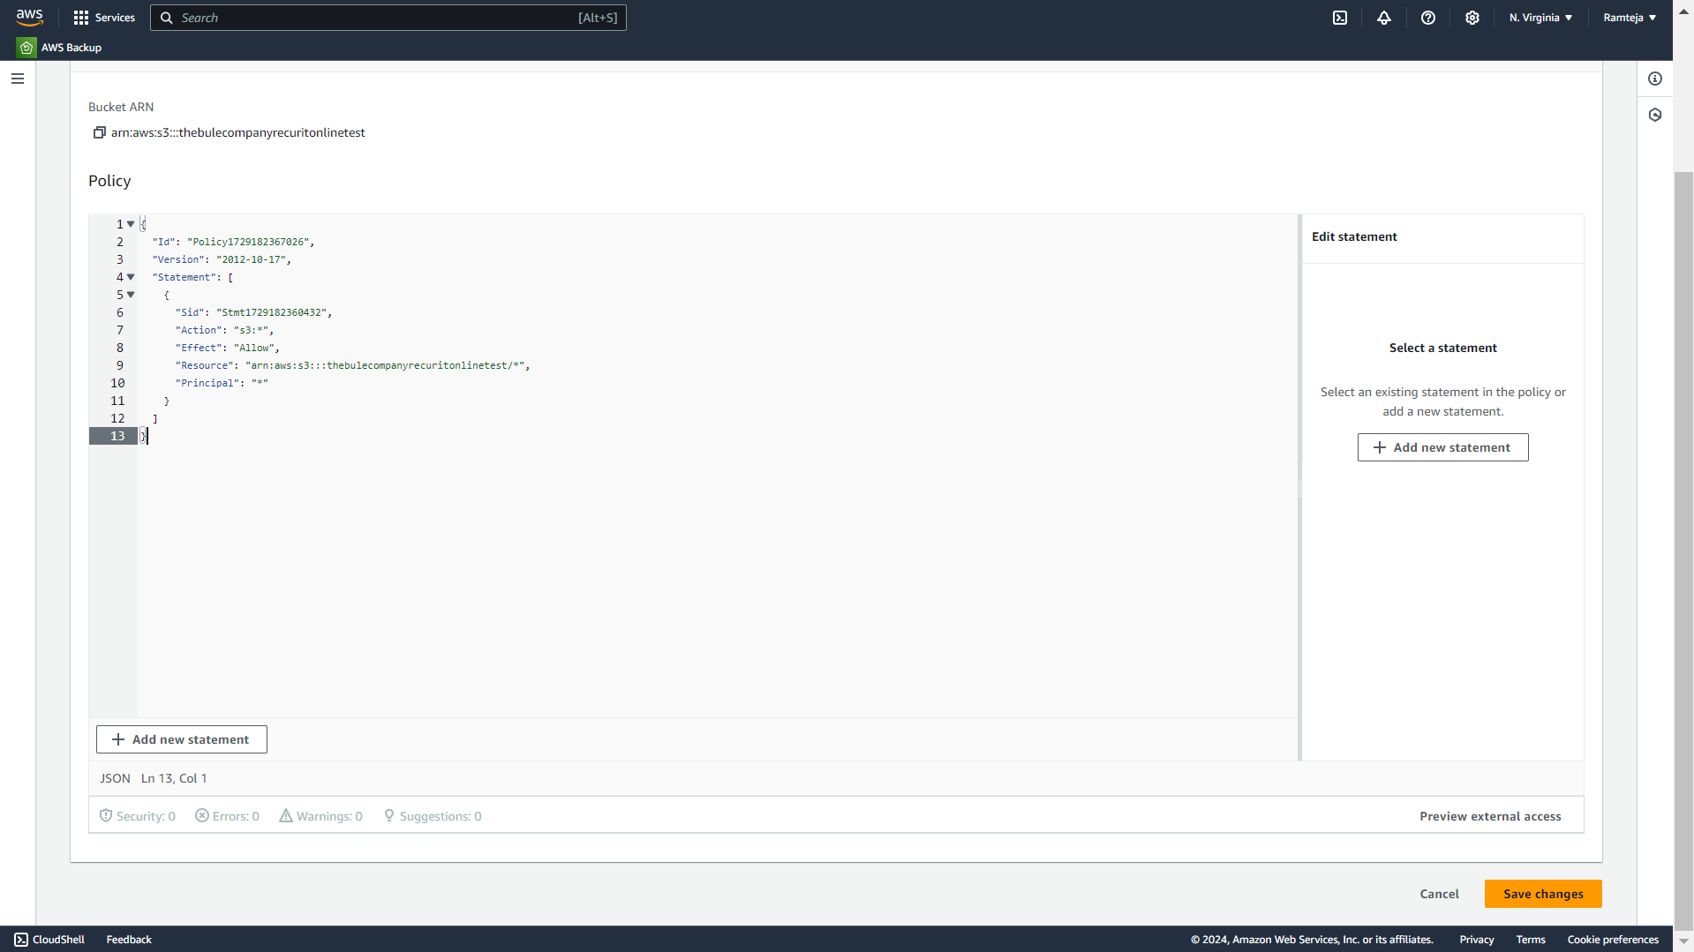
3.19 Paste the Code here & Click on Save.

Slide 55
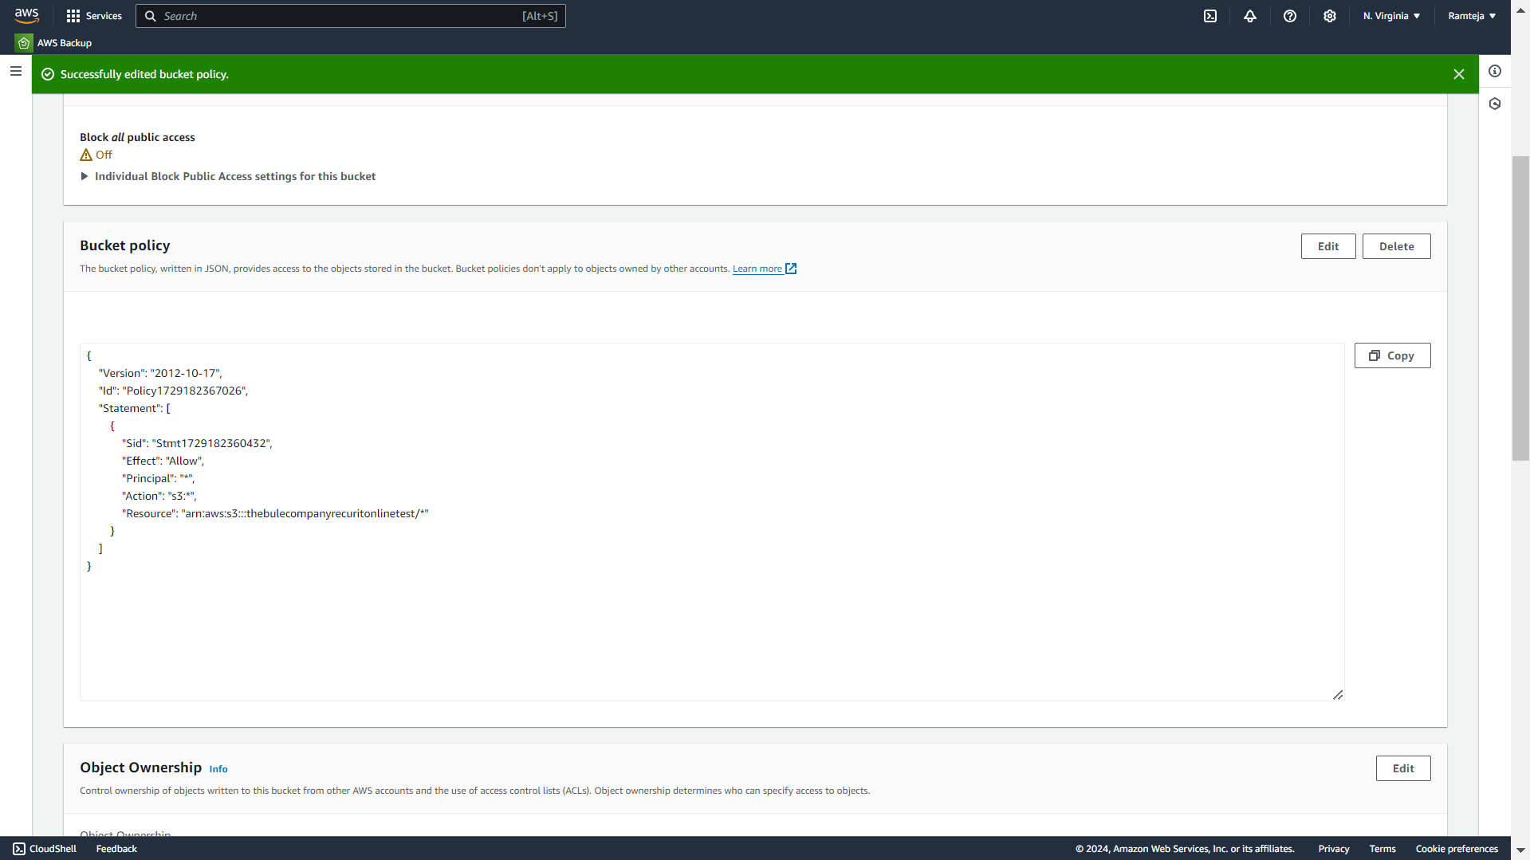
3.20 Bucket Policy is Edited Successfully.

Slide 56
3.21 Copy the Object URL of testlogin.html to share everyone.

Slide 57
4.Setting Up RDS
1.Search for RDS in Search bar and open RDS dashboard, Click on Dashboard.
2.Click on Create Dashboard ,Select Standard Create in Choose Database Creation Method & Select Engine of database.
3.Select Free Tier in Templates , Give Name to database, Create Username & Create Master Password for database in Credential Settings.
4.Select the Instance type, Storage & Select default VPC ,Checkmark Yes in Public Access.
5.Select default Security Group & Choose Availability Zone.
6.Enable Enhance Monitoring In Monitoring & Click on Create.
7.Database is created , Open database , Click on Connectivity & Security.
8.Click on VPC Security groups, Click on default group ,it will direct us to Security group details.
9.Click on Inbound rules , Click on edit Inbound rules & Click add rules – Select Custom TCP with port number 3306(Database port number) & Click on save.
10.Copy the Endpoint of the Database. (Paste it in Lambda & Dbeaver).

Slide 58
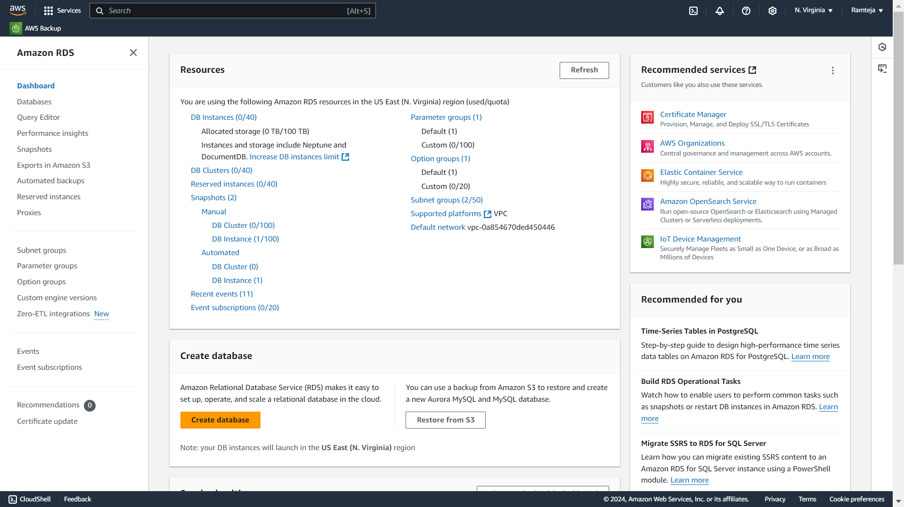
4.1 Click on Dashboard in RDS Dashboard.

Slide 59
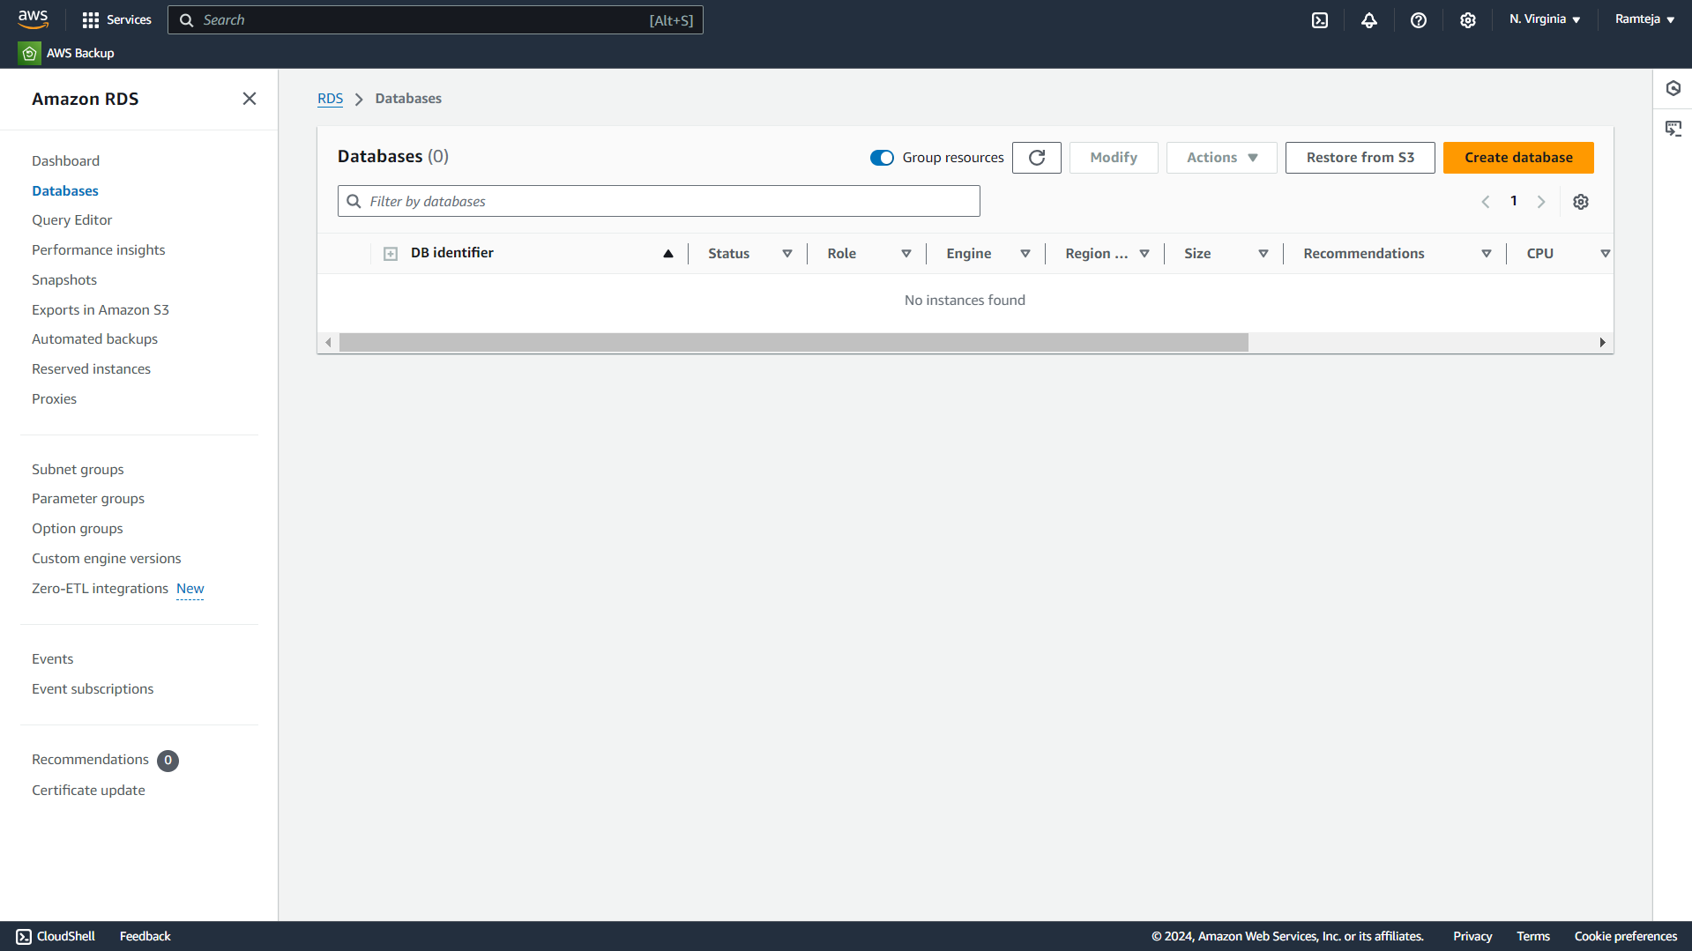
4.2 Click on Create Database.

Slide 60

4.3 Select Standard Create & Engine of database.

Slide 61

4.4 Select Free Tier in Templates.

Slide 62

4.5 Give Name , Username & Create Password for database.

Slide 63

4.6 Select the Instance type & Storage.

Slide 64

4.7 Select default VPC & Public Access as Yes.

Slide 65

4.8 Select VPC Security Group.

Slide 66

4.9 Click on Create database.

Slide 67

4.10 It will Take a while to create database.

Slide 68

4.11 RDS Created Successfully.

Slide 69

4.12 Open the database & Click on Security Groups.

Slide 70

4.13 Click on Security Group.

Slide 71

4.14 Click on Edit Inbound rules.

Slide 72

4.15 Add rule for Custom TCP-3306 and click on save.

Slide 73

4.16 Rule is added to Security Group.

Slide 74
5.DBeaver
1.Install DBeaver & Open.
2.Click on connect to database logo, Search for our Database Engine & Click Next.
3.Paste the Database Endpoint URL in Server Host, Enter the Username, Password & Click on Test Connection.
4.Click on OK & then Finish to Established Connection between RDS Database & Dbeaver.
5.Expand Database-1,Right Click on New Database & Enter Database name Click on OK.
6.Expand data1,Right click on it ,Select SQL editor & Open SQL Script.
7.To create a table in “testdata” database , copy the query1 in the script.
8.Run the SQL query , Table has been created & Expand the table in formdata1 database.
9.To insert the candidate login credentials ,copy query 2
10.To display the table Copy the query3 in the Script & Run the query then table is displayed.

Slide 75
Query-1
CREATE TABLE exam_results (
email VARCHAR(255) PRIMARY KEY,
password VARCHAR(255) NOT NULL);
Query -2
INSERT INTO exam_results (email, password) VALUES(
'student1@example.com','password123'),('student2@example.com','password234'),
('student3@example.com','password345'),('student4@example.com','password456'),
('student5@example.com','password567'),('student6@example.com','password678'),
('student7@example.com','password789'),('student8@example.com','password890'),
('student9@example.com', 'password901'),('student10@example.com', 'password012');
Query -3
SELECT * FROM exam_results;
These queries are used to create a table, that stores the email , password in “exam_results” table in “testdata” database in RDS.

Slide 76
Query -4
CREATE TABLE exam_testresults (
email VARCHAR(255) PRIMARY KEY,
password VARCHAR(255) NOT NULL,
totalMarks INT NOT NULL,
score DECIMAL(5, 2) NOT NULL,
percentage DECIMAL(5, 2) NOT NULL,
passFailMessage VARCHAR(100),
details TEXT);
Query -5
SELECT * FROM exam_results;
These queries are used to create a table, that stores the result in “exam_testresults” table in “testdata” database in RDS.

Slide 77

5.1 Open Dbeaver & Click on connect to database logo.

Slide 78


5.2 Search for our Database Engine & Click on Next.

Slide 79

5.3 Paste the Database URL in Server Host , Click on Test Connection.

Slide 80

5.4 Click on OK & Click on Finish.

Slide 81

5.5 Expand the resultdata & Right click on Database.

Slide 82


5.6 Create New Database & Click on ok.

Slide 83

5.7 Expand Database in testdata.

Slide 84

5.8 Right Click on New database & Select Open SQL script.

Slide 85

5.9 exam_results table created in database testdata.

Slide 86

5.10 Insert the data of logins into table.

Slide 87

5.11 Data inserted Successfully.

Slide 88

5.12 Create a another table in testdata to store test results.

Slide 89

5.13 Display the table in exam_testresults.

Slide 90
6. Working of Website- Login page.

Slide 91

6.1 Login Details

Slide 92

6.2 Login Successful

Slide 93

6.3 Click on Start the Test for exam

Slide 94

6.4 Click on OK

Slide 95
6.5 Start the Technical Test

Slide 96
6.6 After test ,Click on Submit button

Slide 97

6.7 Result after the test

Slide 98

6.8 Data Stored in RDS.

Slide 99

6.9 If candidate try to submit again.

Slide 100
7.Monitoring
1.Monitoring Lambda Function
1. Cloud Watch Logs for Lambda.
2. Detailed information of Request from Website to RDS.
3. Some logs of Website taking Data Successfully.
4. Cloud Watch Metrics
2.Monitoring Database
1. RDS Logs & Events.
2. Cloud Watch Metrics of RDS.
3. Maintenance , Backup & Snapshots in RDS.

Slide 101

7.1.1 Metrics of Testlogin Lambda.

Slide 102

7.1.2 Metrics of Testevaluation Lambda.

Slide 103

7.1.3 Logs of Testlogin lambda.

Slide 104


Slide 105

7.1.4 Logs of Testevaluation lambda.

Slide 106


Slide 107


Slide 108

7.2.1 Metrics of RDS.

Slide 109


Slide 110

7.2.2 Events of RDS.

Slide 111

7.2.3 Logs of RDS.

